Slide 1

Universal Hydraulic Disconnect
Publisher: Jalal Al Ali
2018.11

Slide 2
CONTENT
Introduction of Tool
Disassembly
Assembly

Slide 3
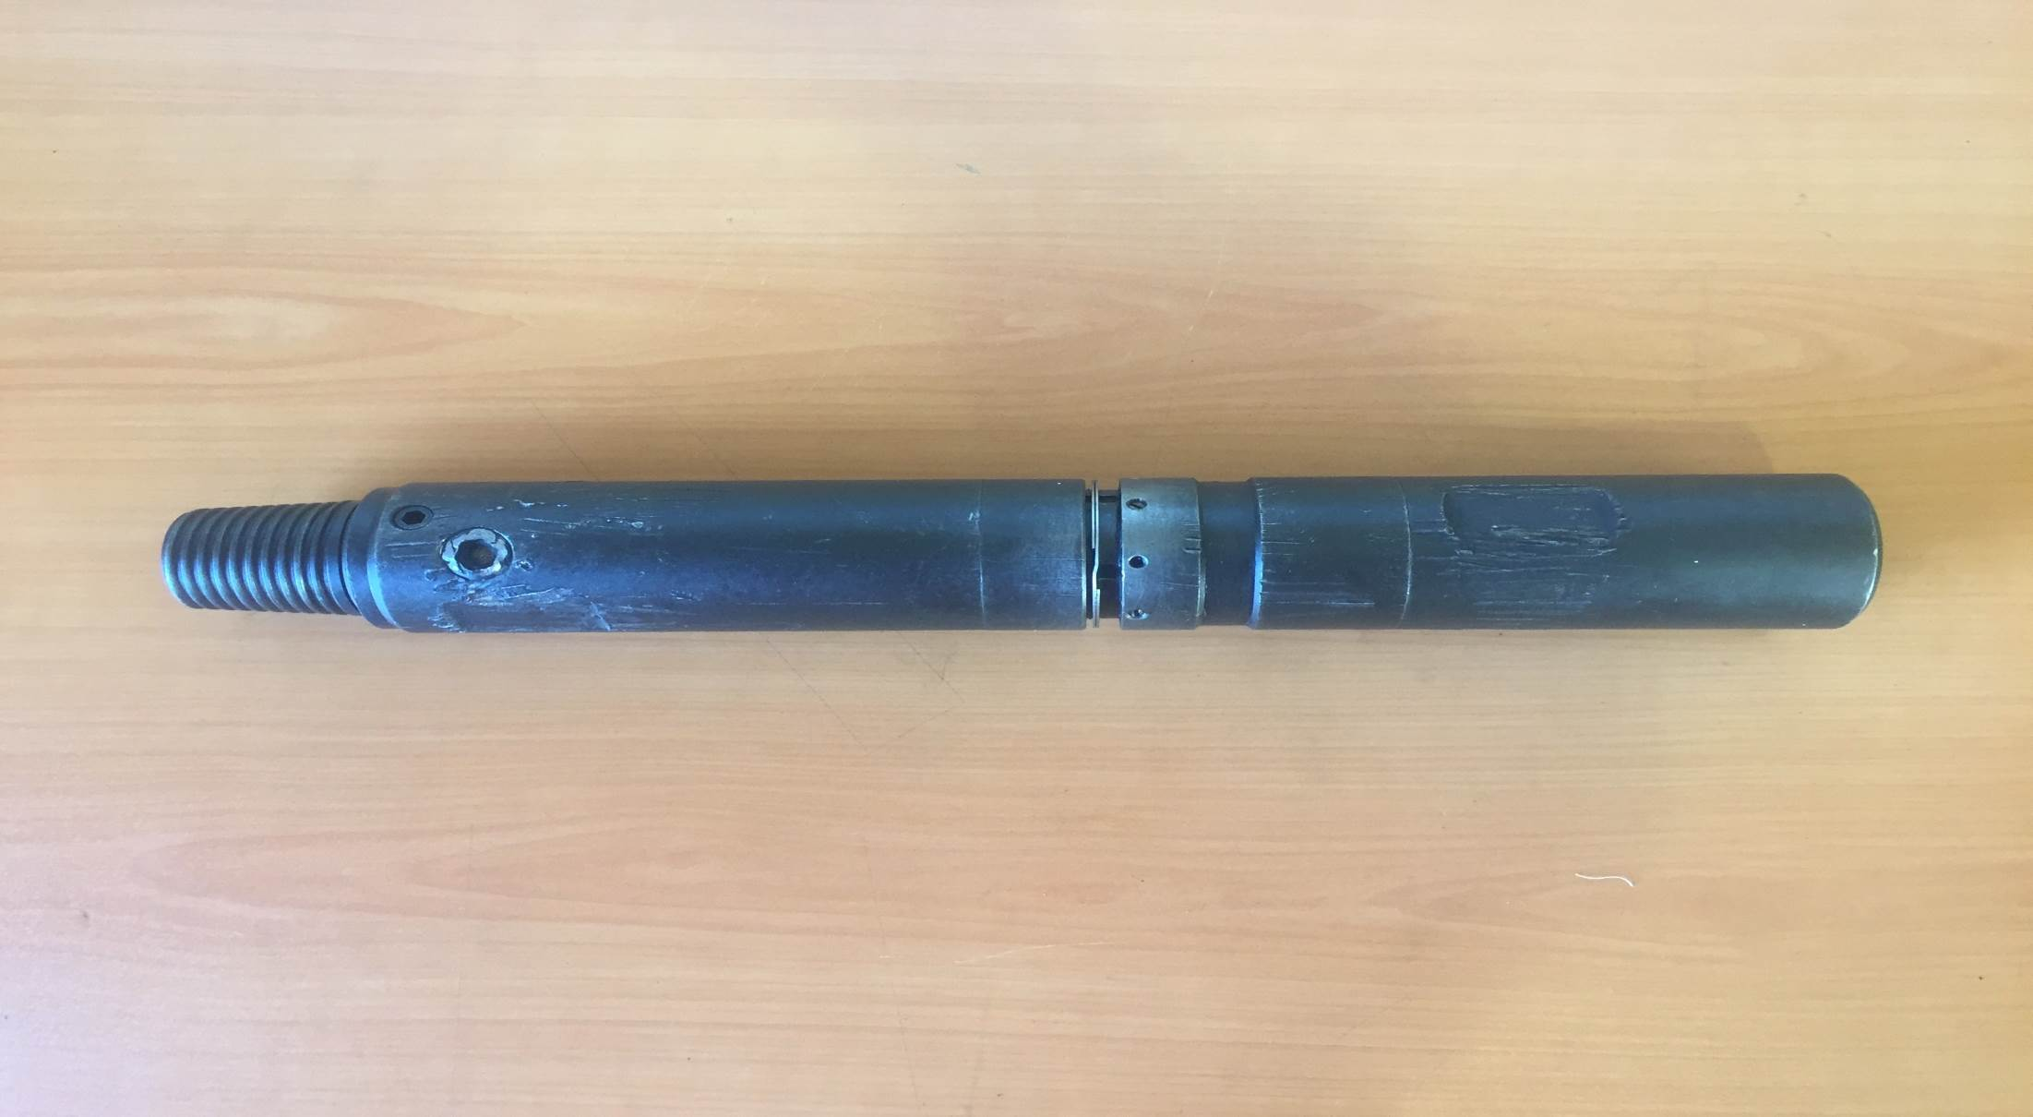

Slide 4
Introduction:
The Universal Hydraulic Disconnect is ball-operated emergency release device designed to be run in a coil tubing application to provide a method of separating from tools below the disconnect . This disconnect incorporates all features to withstand all forces encountered during fishing and milling operation. The universal hydraulic disconnect has a high shock load strength , high tensile strength rotationally and has a shorter length when compared to other hydraulic disconnect .

Slide 5
Features and Benefits:
Able to withstand any jarring and impacting operation
Debris barrier system
Unique locking mechanisms with adjusting ring
Rotationally locked for downhole motor and torque applications
Available torque through feature available for fishing operations
Circulations ports for flowing through disconnected tool

Slide 6
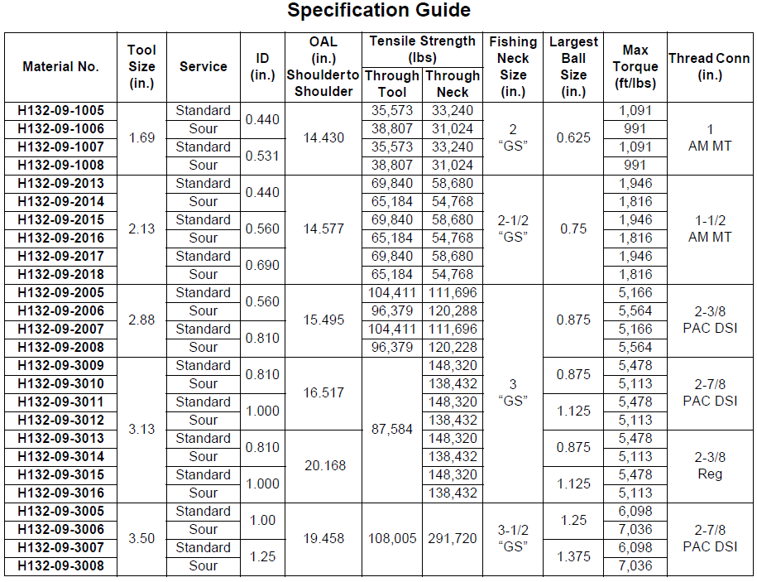

Slide 7
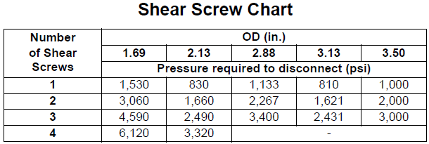

Slide 8
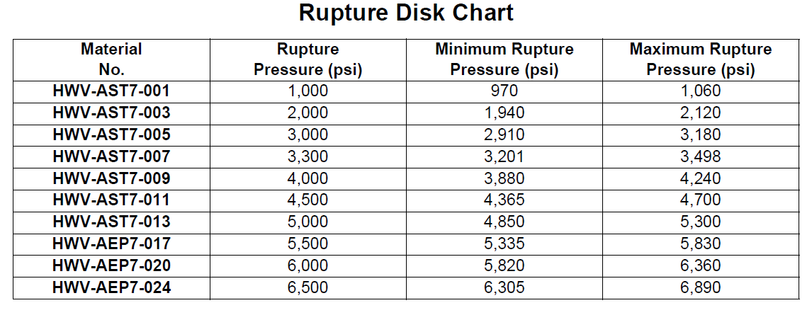

Slide 9
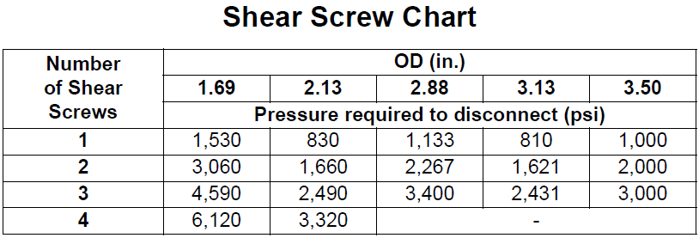

Slide 10
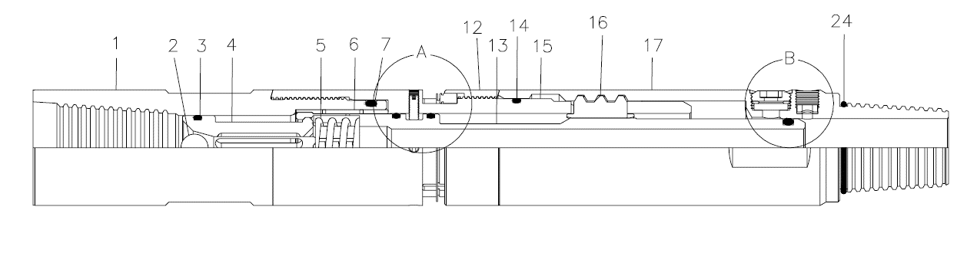

Slide 11
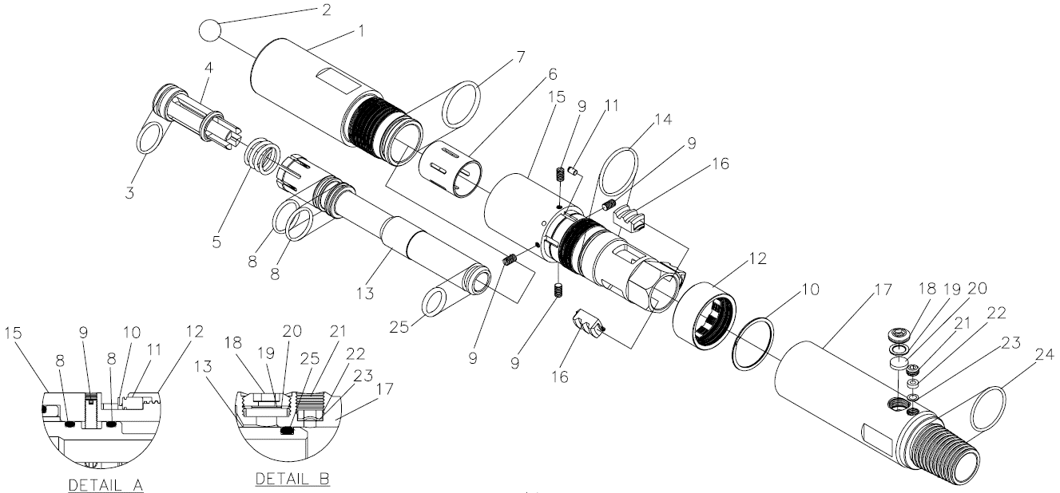

Slide 12
Amount | Description | Item No.
1 | Top Sub | 1
1 | Steel Ball | 2
1 | O-ring | 3
1 | Piston | 4
1 | Compressing Ring | 5
1 | Collet Sleeve | 6
1 | O-ring | 7
2 | O-ring | 8
4 | Shear Screw | 9
1 | Retaining Ring | 10
1 | Locking Pin | 11
1 | Adjusting Ring | 12
1 | Collet | 13
Amount | Description | Item No.
1 | O-ring | 14
1 | Dog Housing | 15
3 | Dog | 16
1 | Seating Dog | 17
1 | Filter Plug | 18
1 | Washer | 19
1 | Snubber Filter | 20
1 | Hold Down Plug | 21
1 | Hold Down Ring | 22
1 | Rupture Dist | 23
1 | O-ring | 24
1 | O-ring | 25
- | - | 26

Slide 13
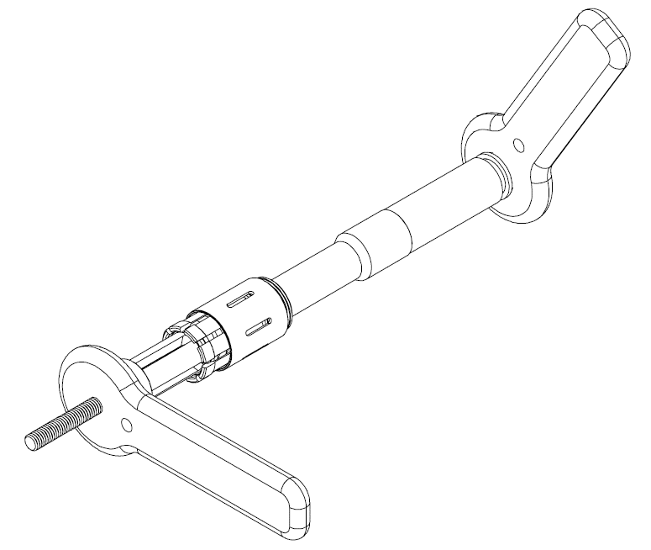

Slide 14
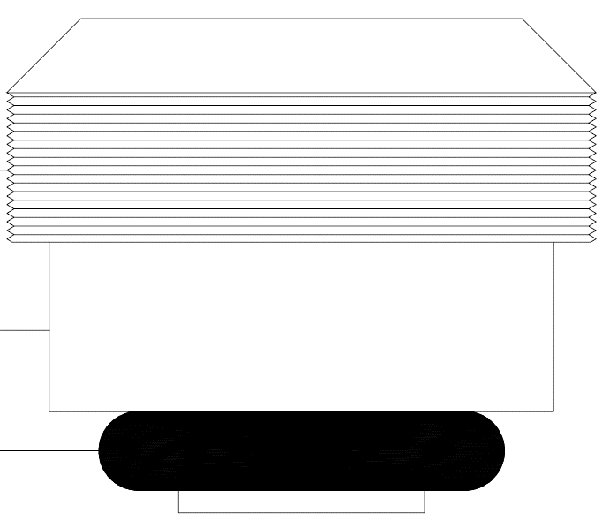

Slide 15
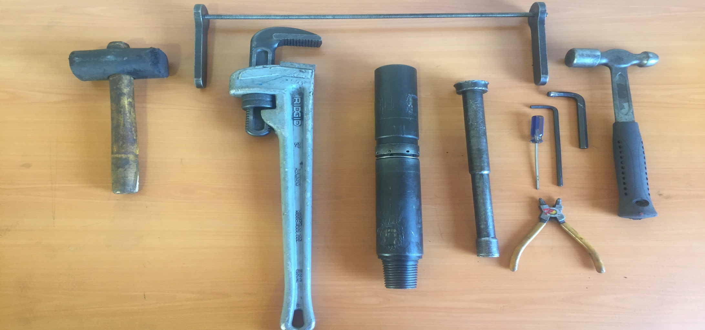
Required Hand Tools
Pipe Wrench
Allen Key
Rubber Hammer
Bowl
Flat Bar

Slide 16
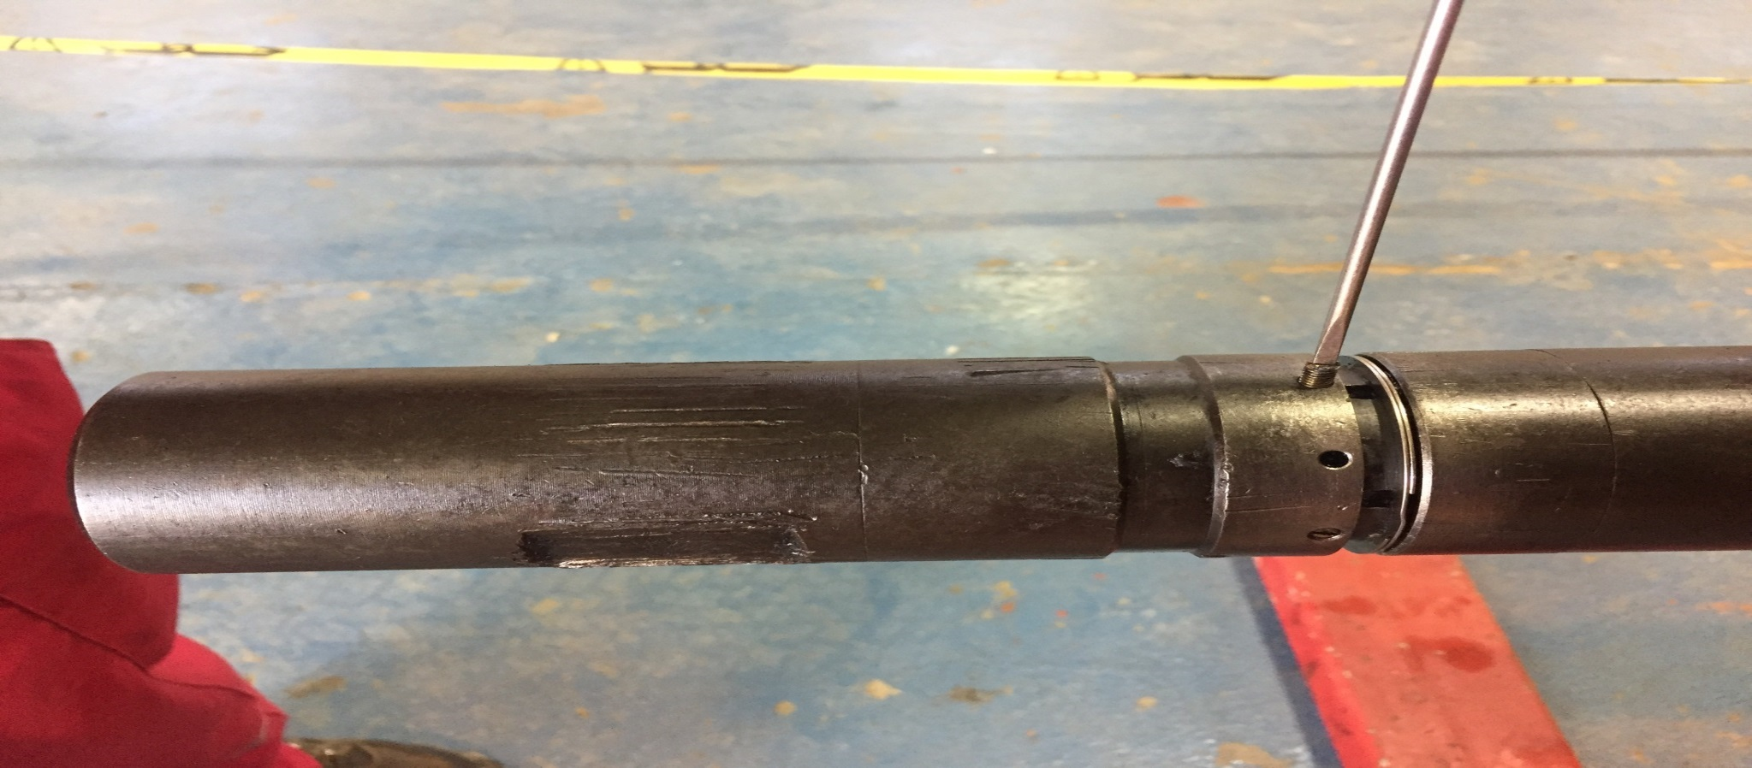
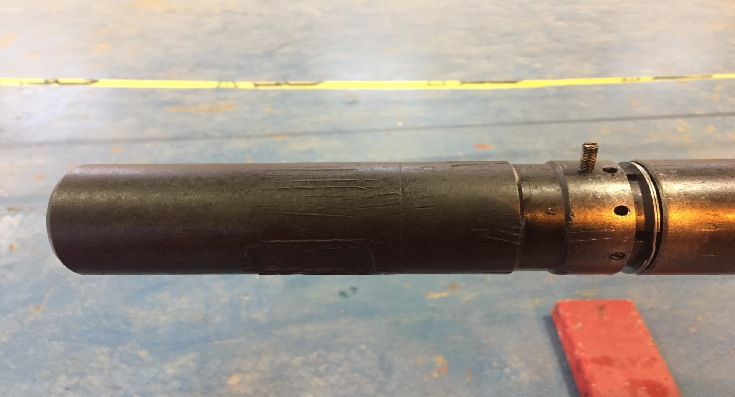
Remove shear screws (9) from the dog housing (15).
A
B

Slide 17
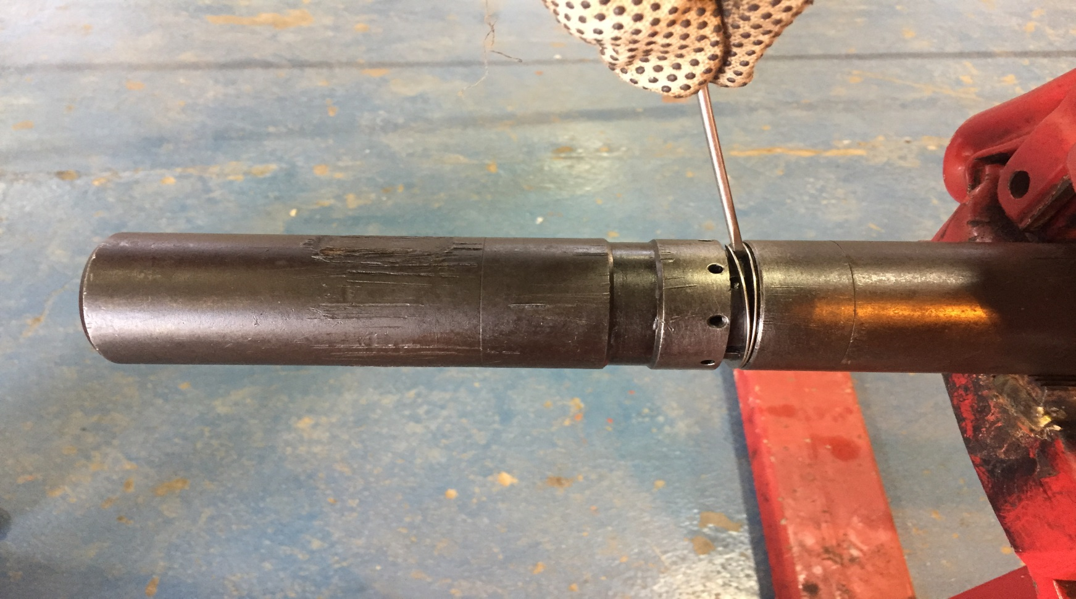
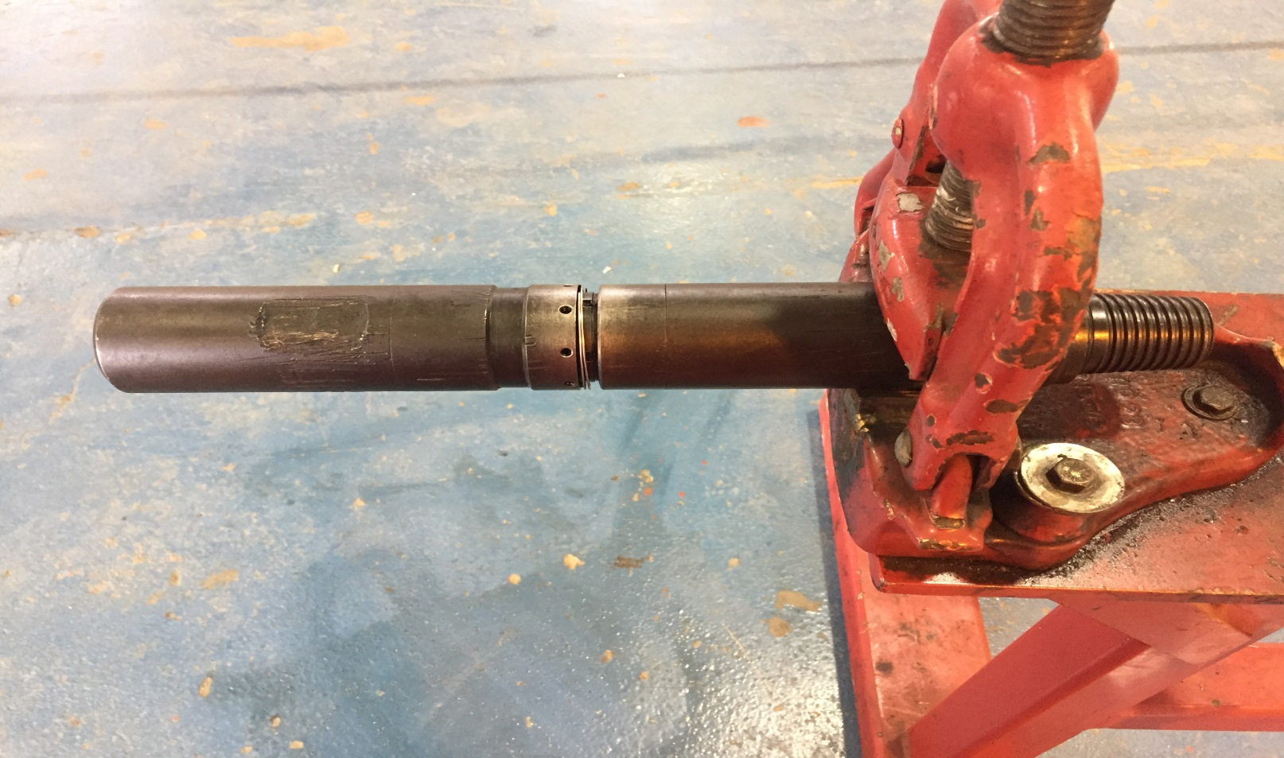
Expand retaining ring (10) and slide up and away from the locking pin (11).
A
B

Slide 18
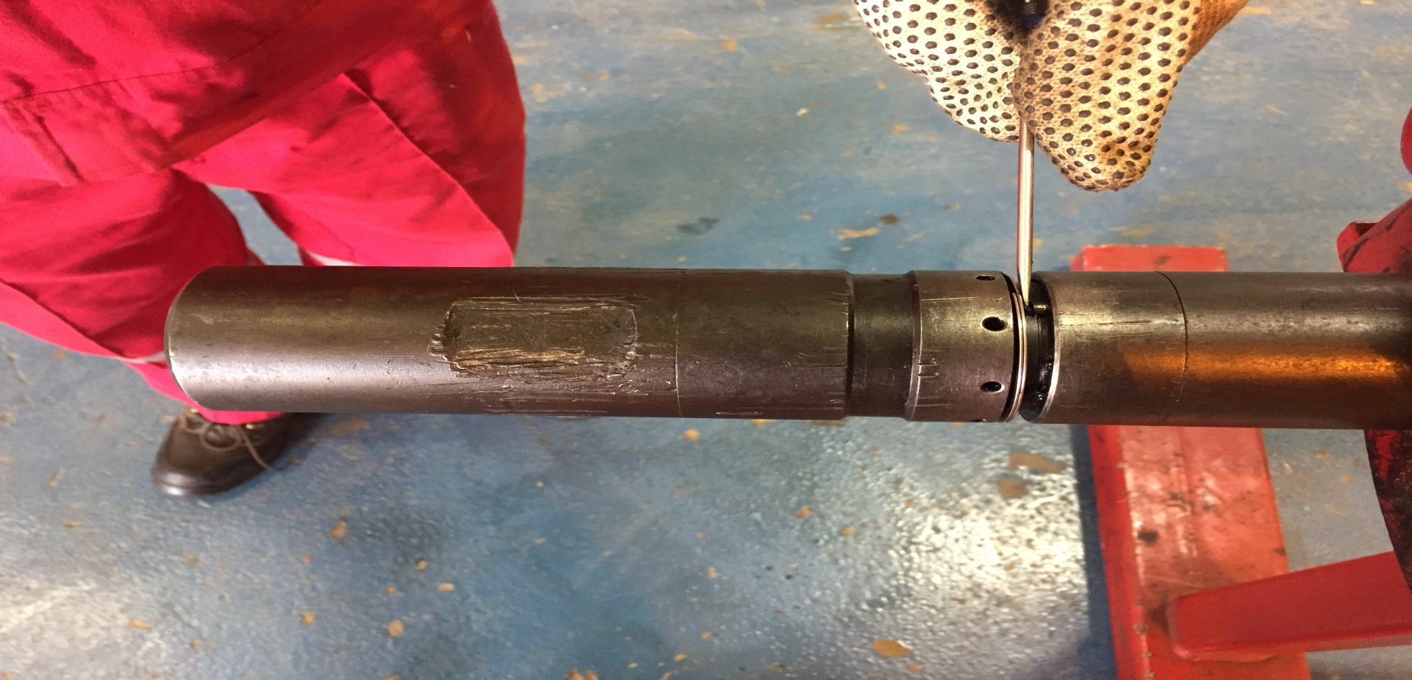
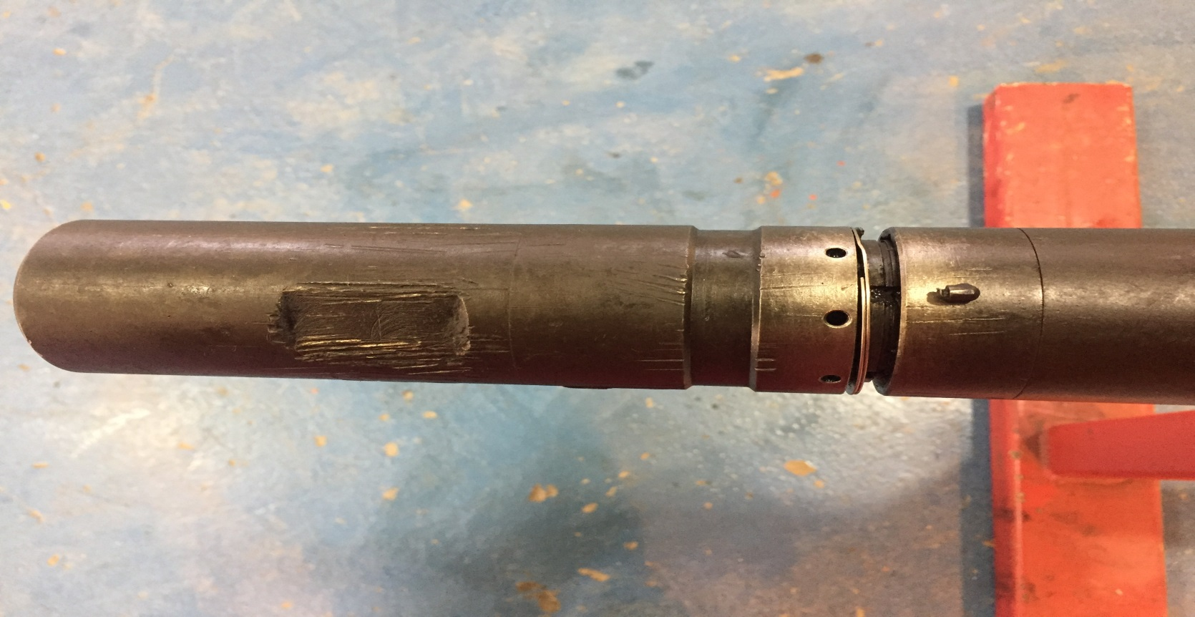
Slide the locking pin (11) out from under the adjusting ring (12) and remove.
A
B

Slide 19
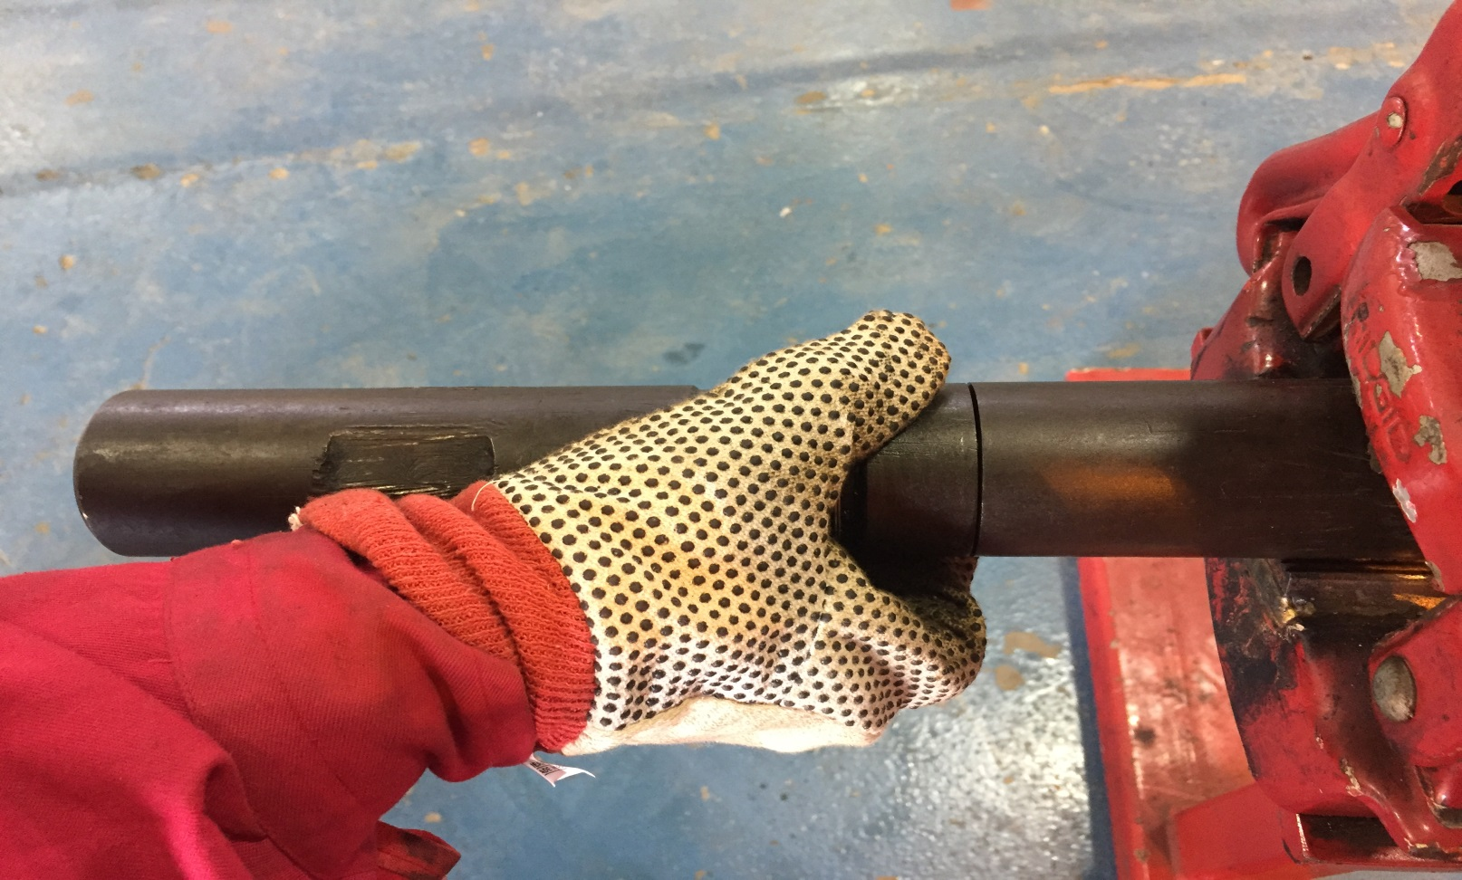
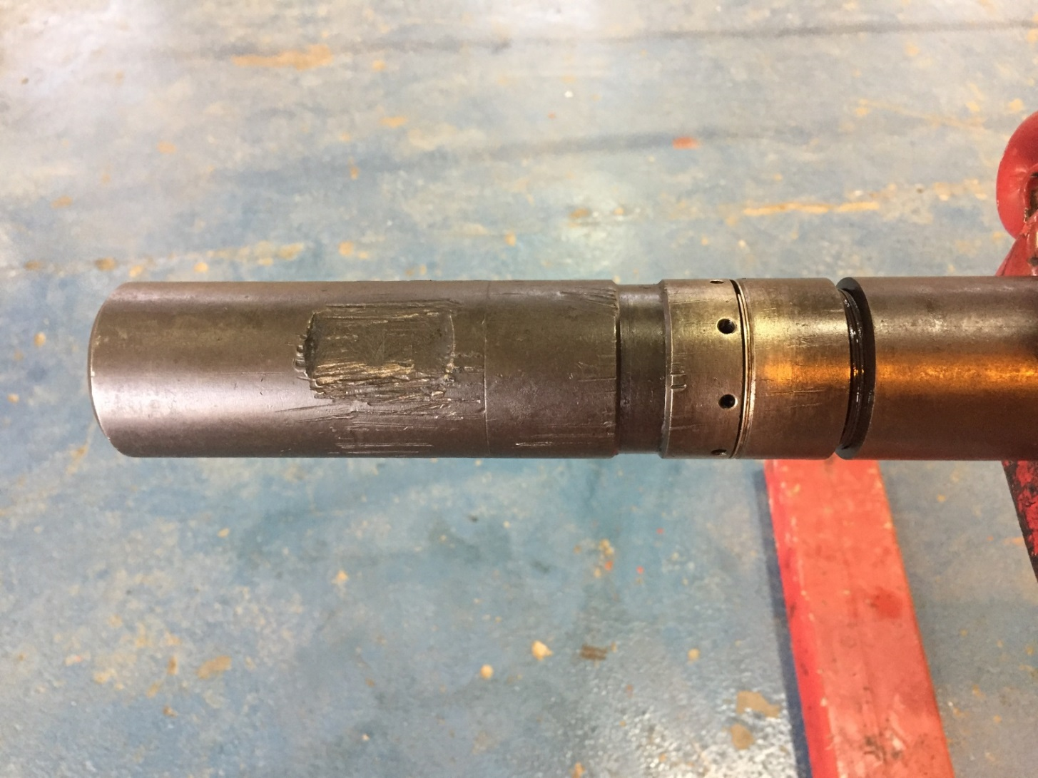
Un-tighten the adjusting ring (12).
A
B

Slide 20
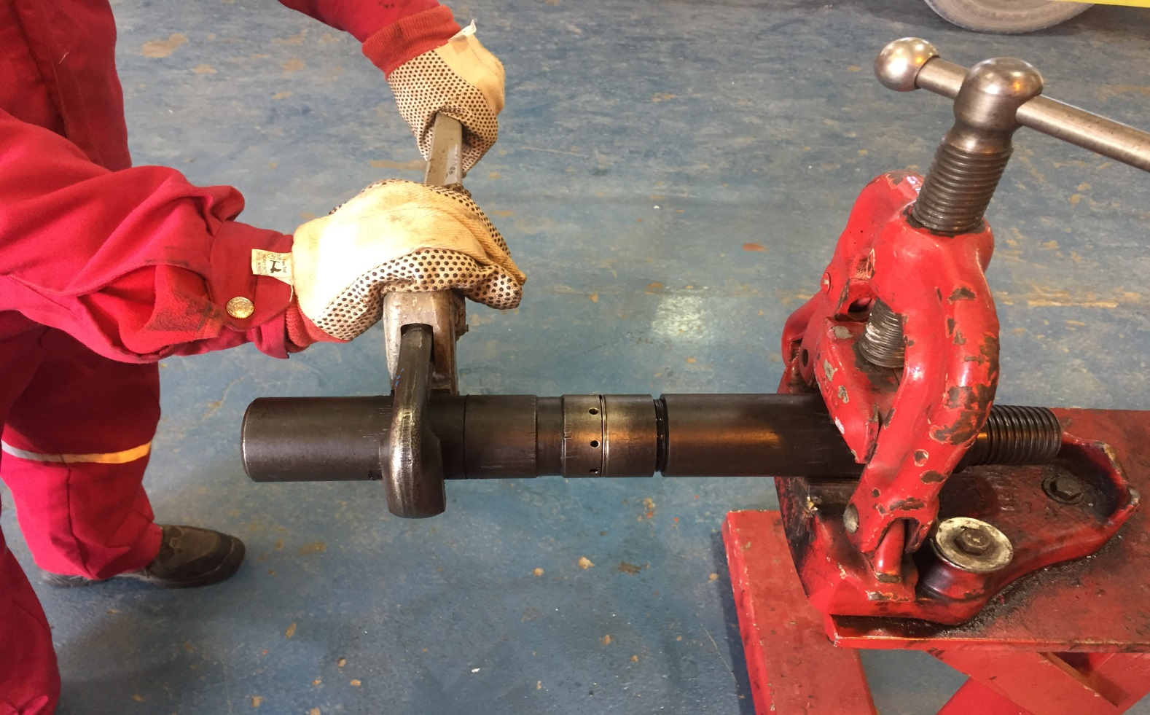
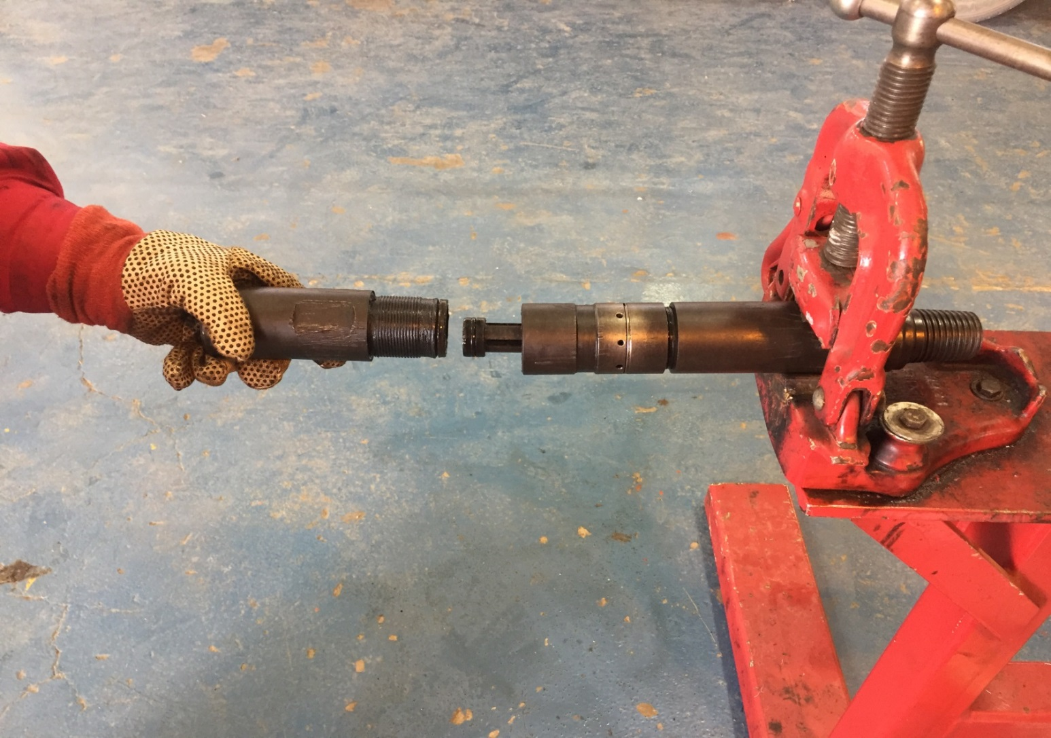
Un-thread the top sub (1) from the dog housing (15).
A
B

Slide 21
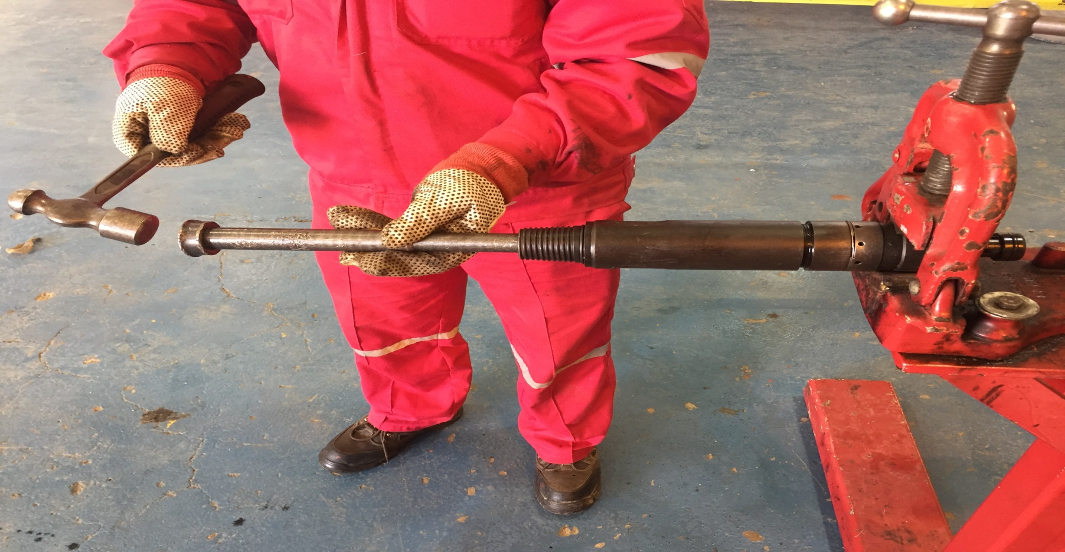
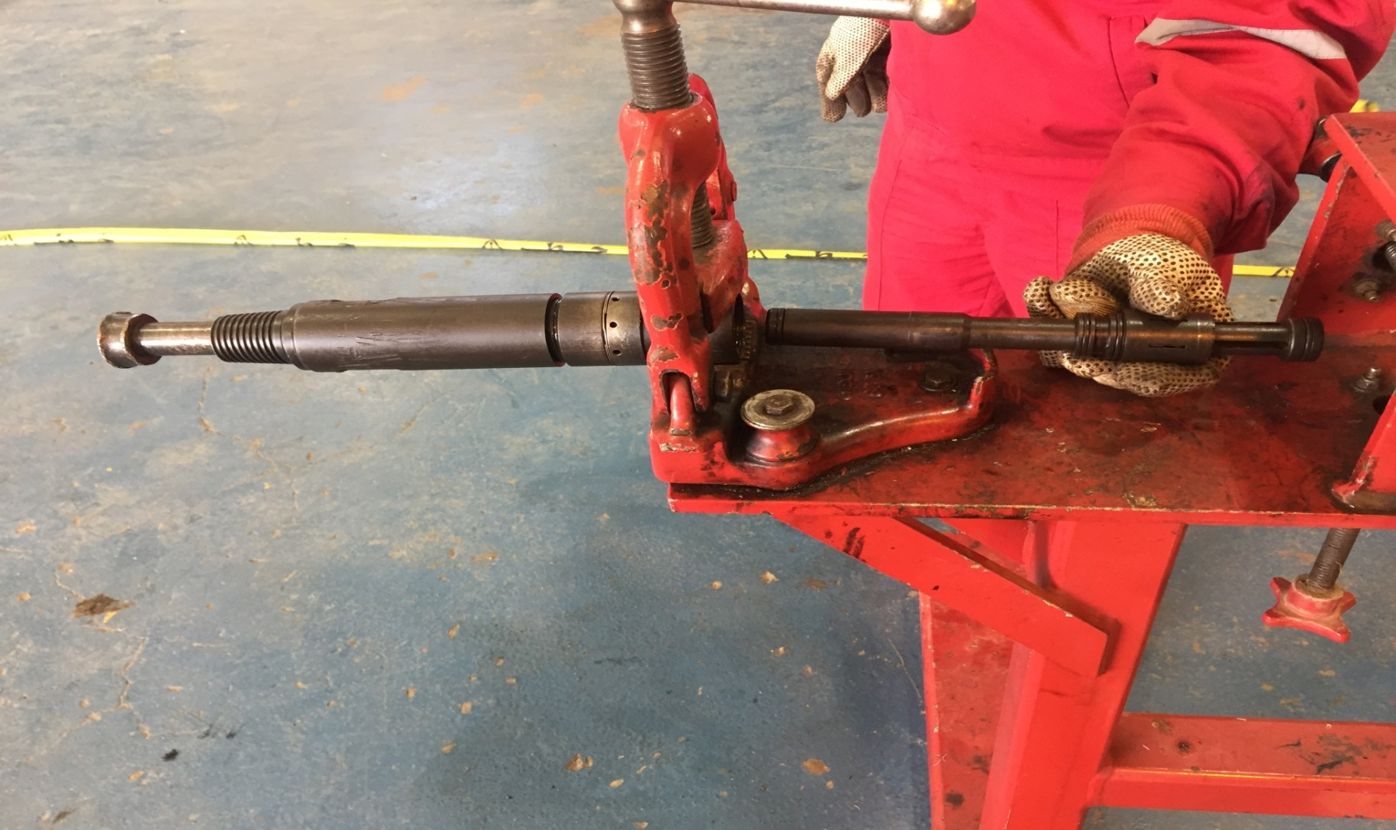
Pull the piston (4), spring (5), collet sleeve (6) and collet (13) from the dog housing (15).
A
B

Slide 22
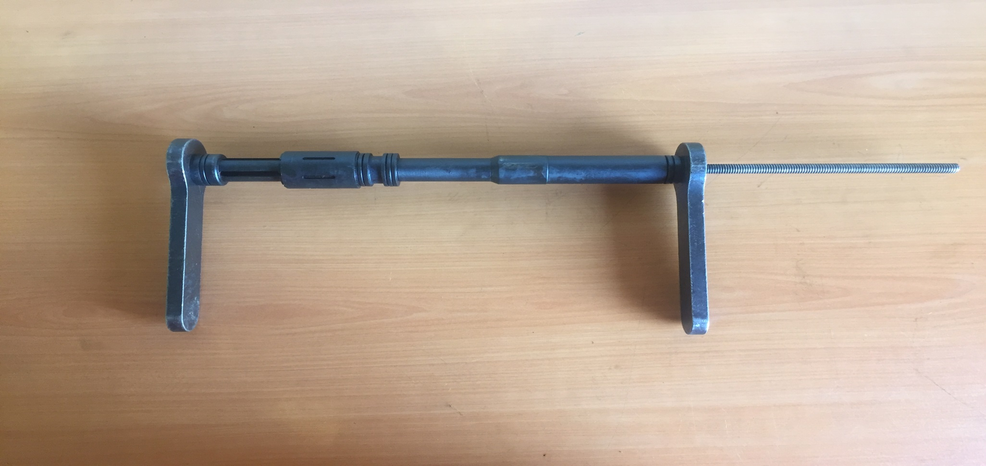
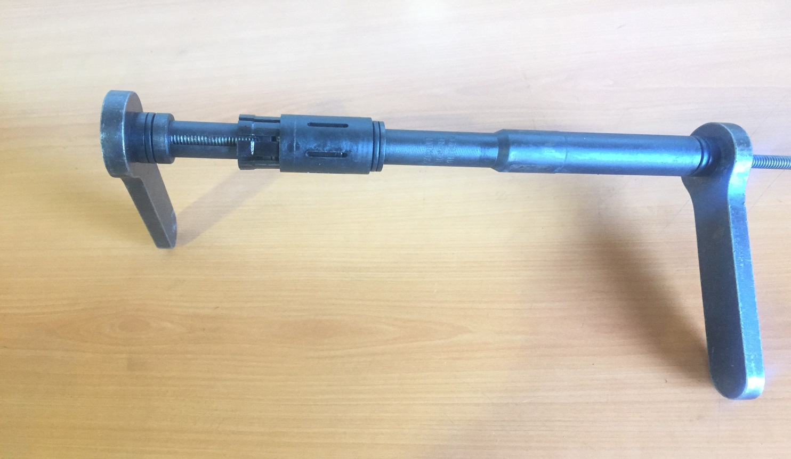
Insert the all thread assembly tool through the piston (4) and the collet. Tighten to unload the spring (5).
A
B

Slide 23
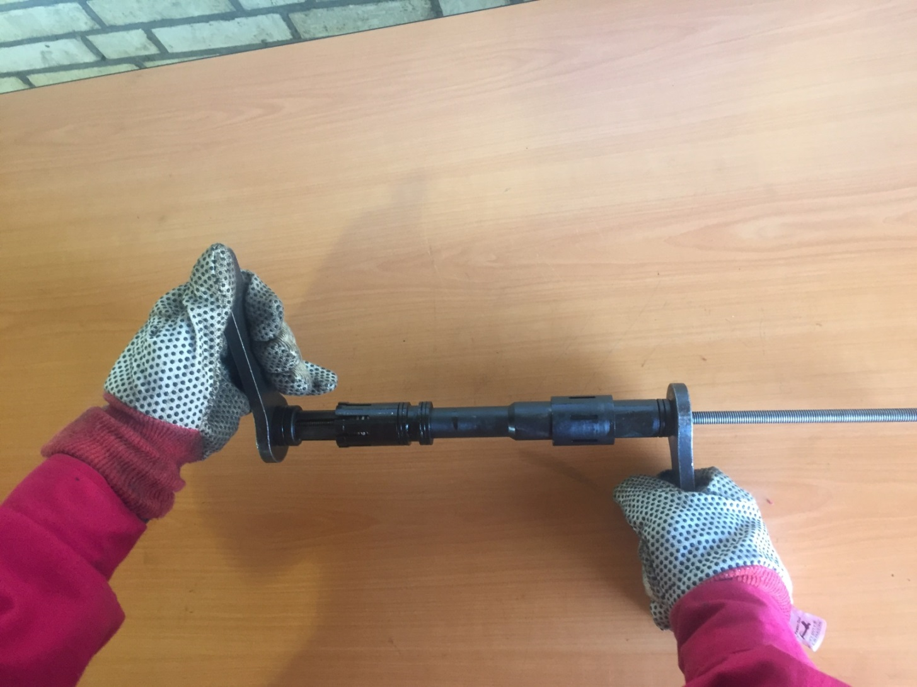
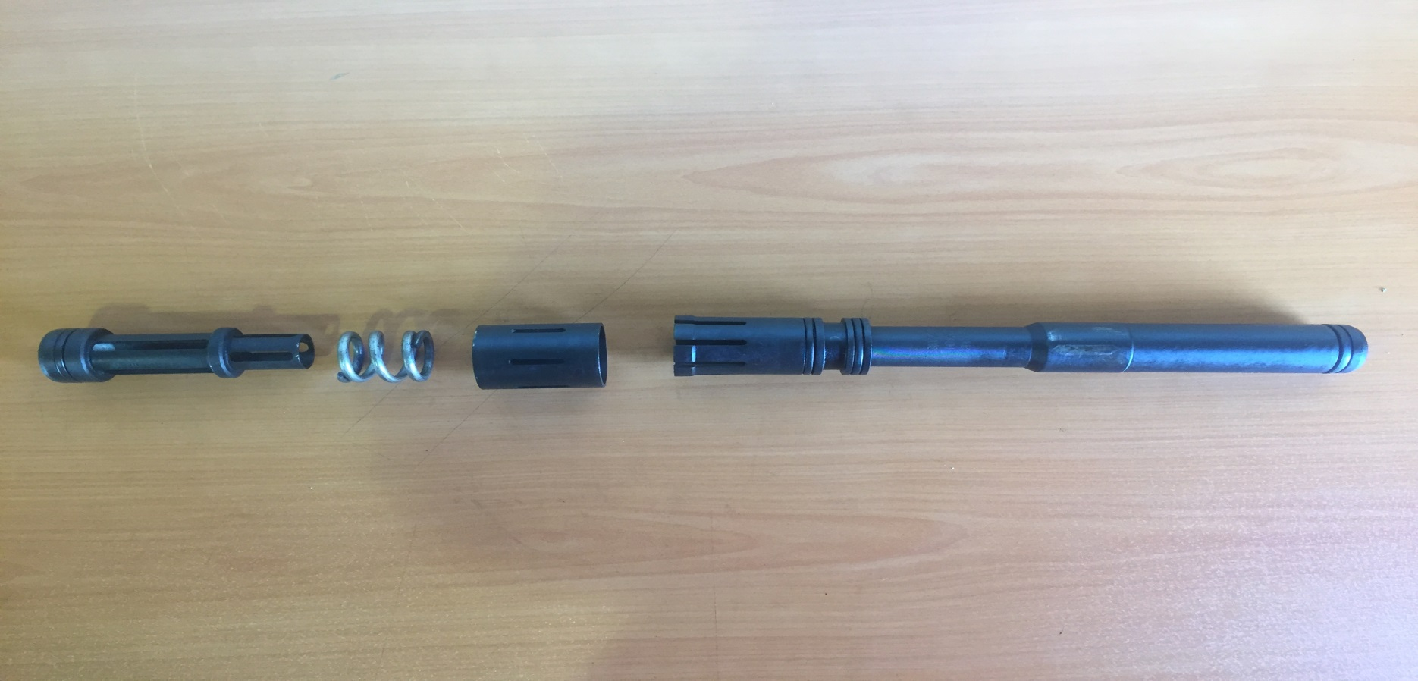
Slide the collet sleeve (6) off of the collet (13). Loosen the nut on the all thread and remove complete compression on the spring.
A
B
Note: do not slide the collet sleeve (6) without the all-thread assembly install. The spring (5) is under high load and can result in injury.

Slide 24
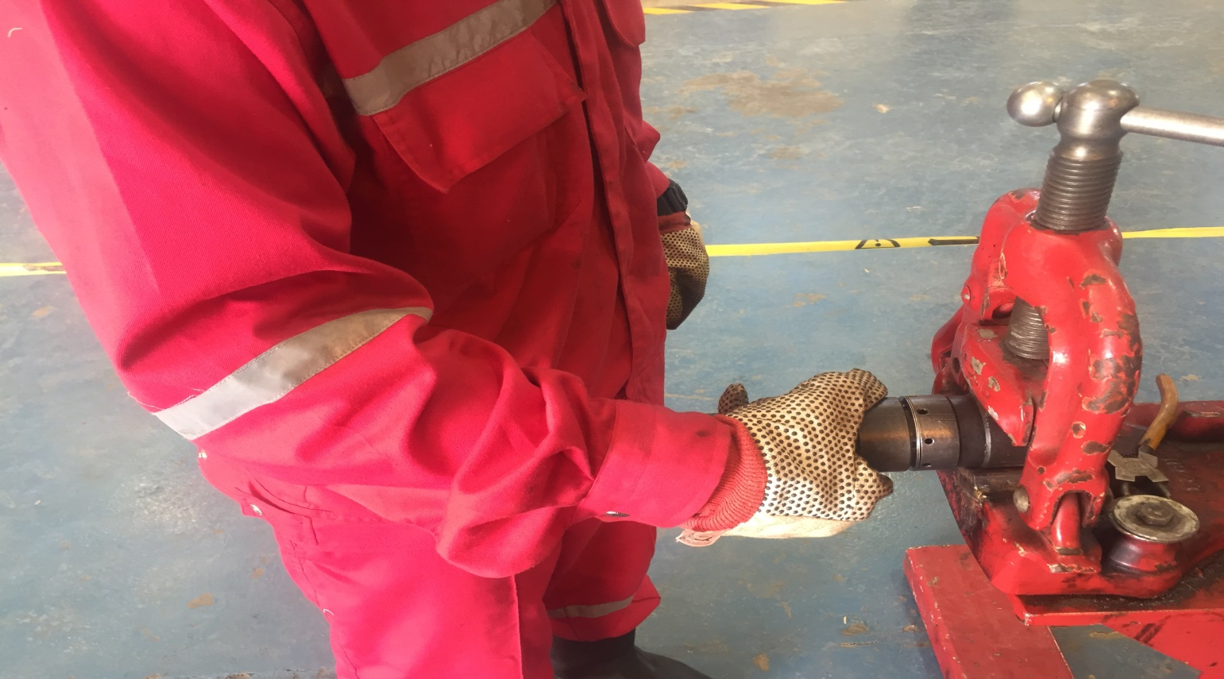
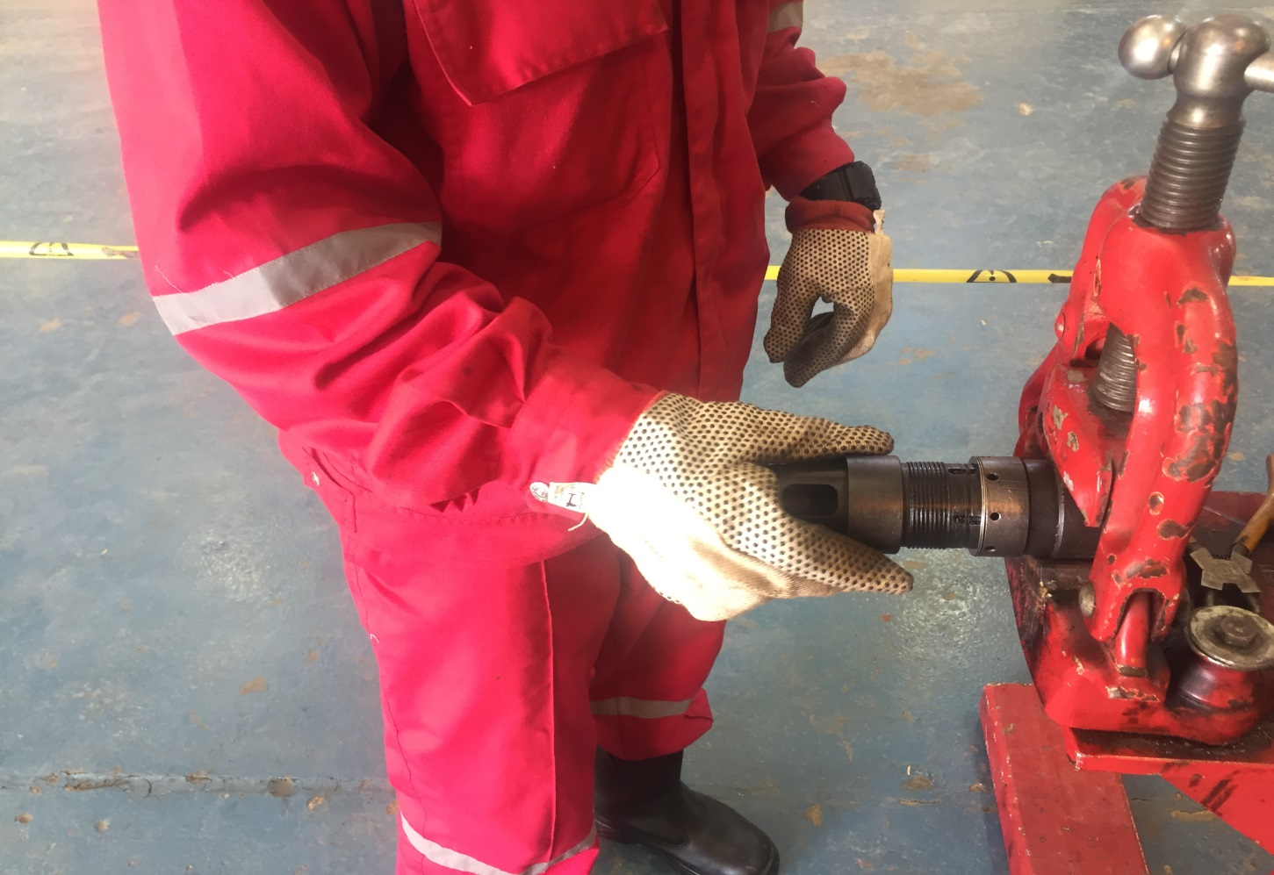
Pull the dog housing (15) out of the seating dog (17) and remove the O-ring (14) and adjusting ring (12) from the dog housing (15).
A
B

Slide 25
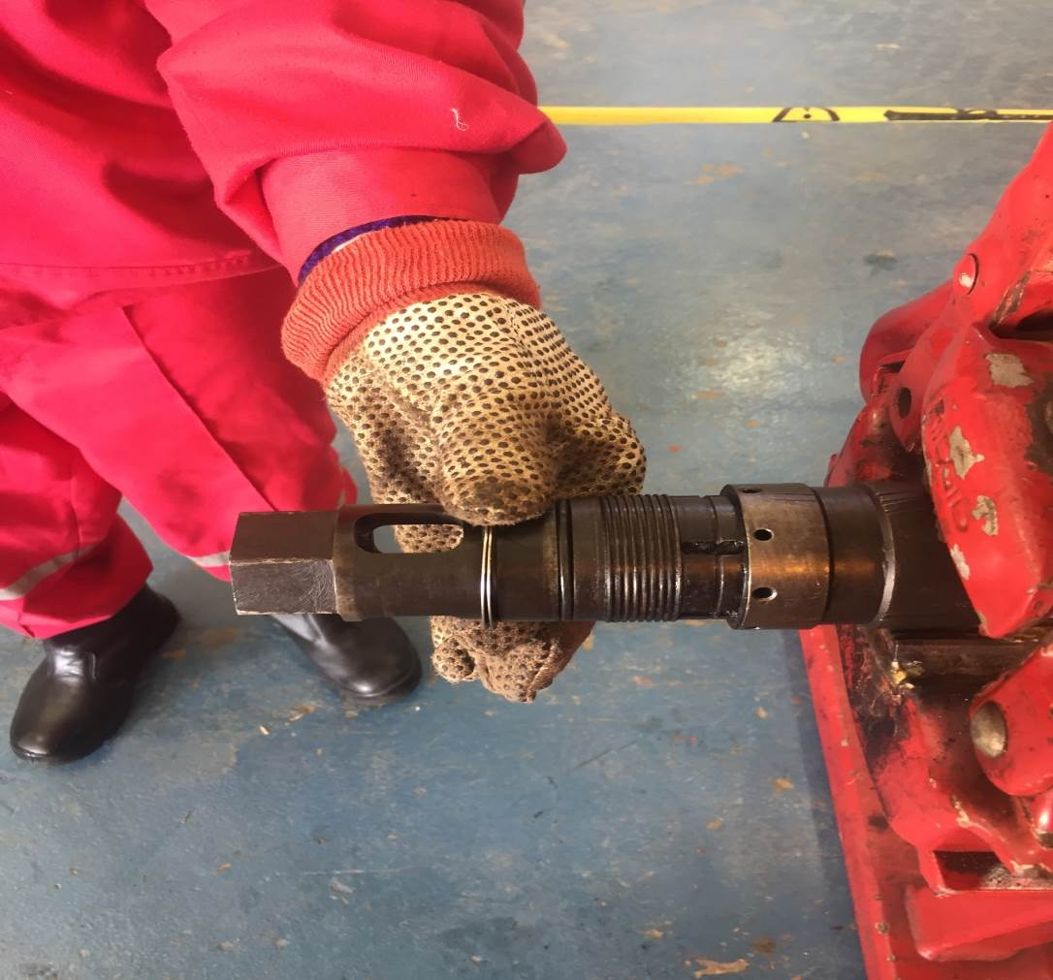
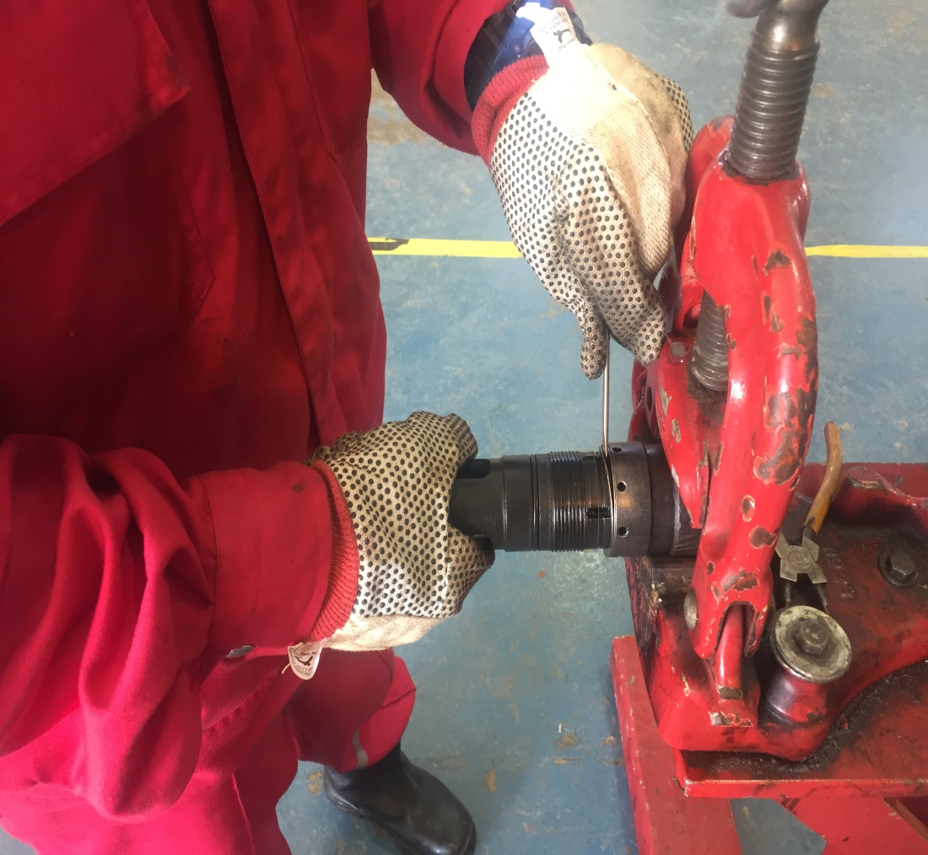
Remove the retaining ring (10) and dogs (16) from the dog housing (15).
A
B

Slide 26
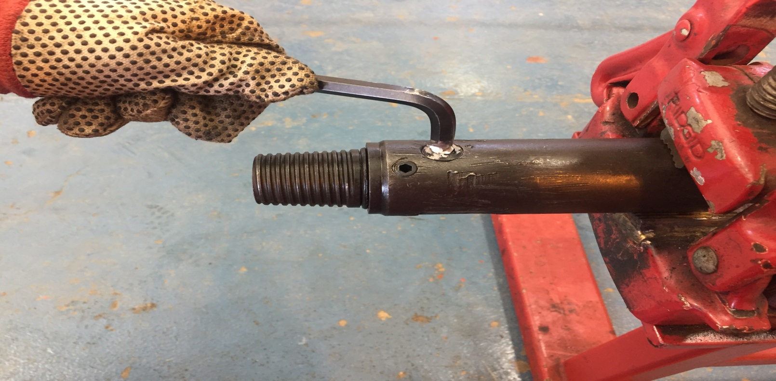
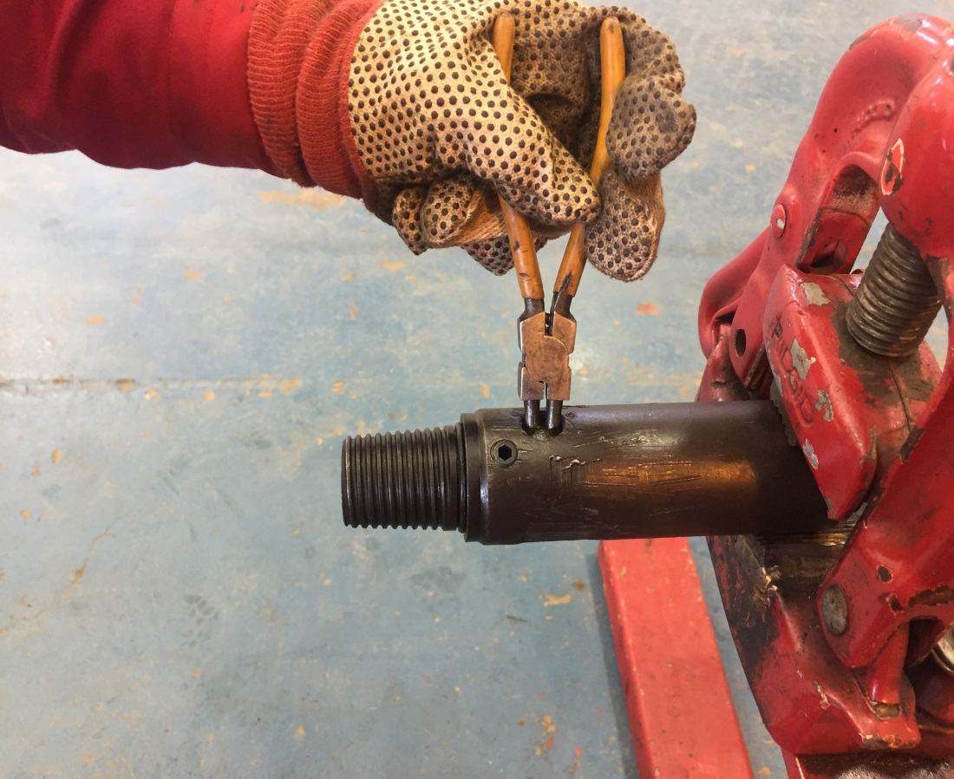
Remove the filter plug (18), washer (19) and snubber filter (20) from the seating dog (17).
A
B

Slide 27
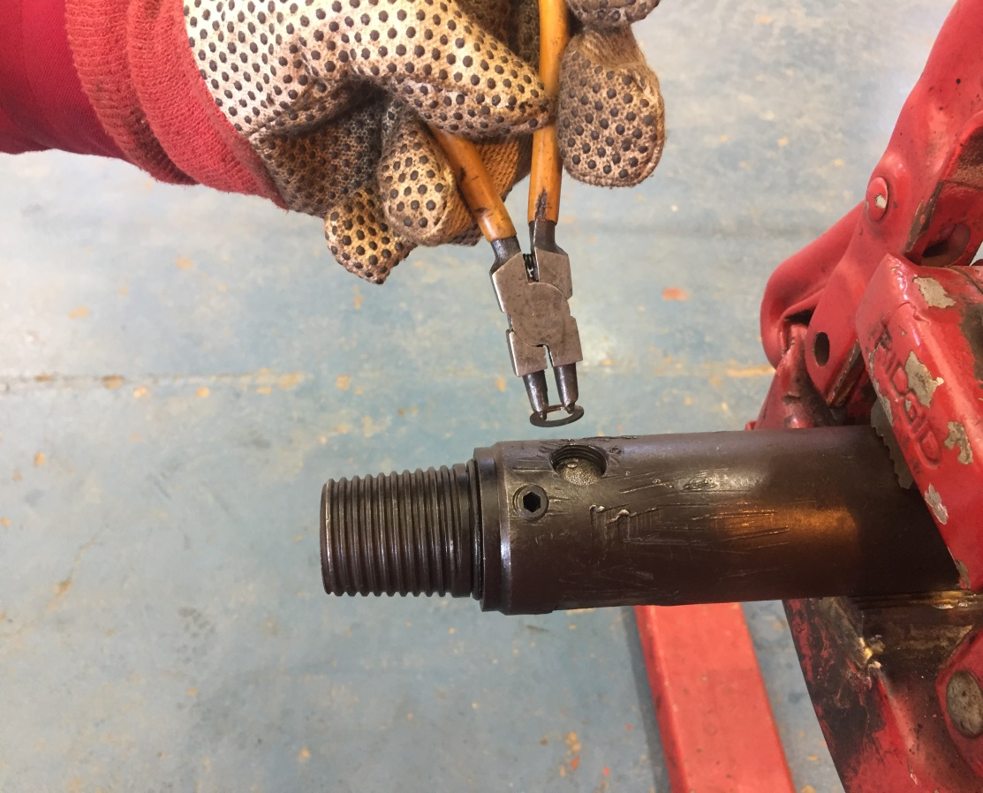
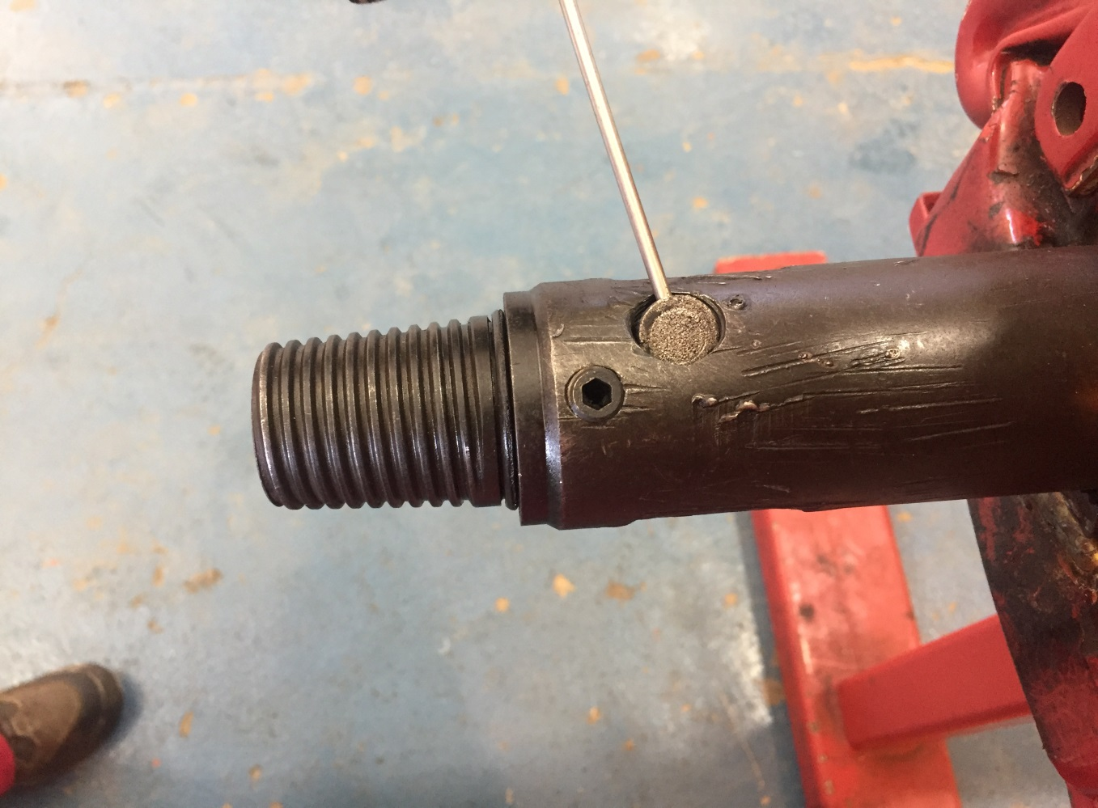
Remove the filter plug (18), washer (19) and snubber filter (20) from the seating dog (17).
C
D

Slide 28
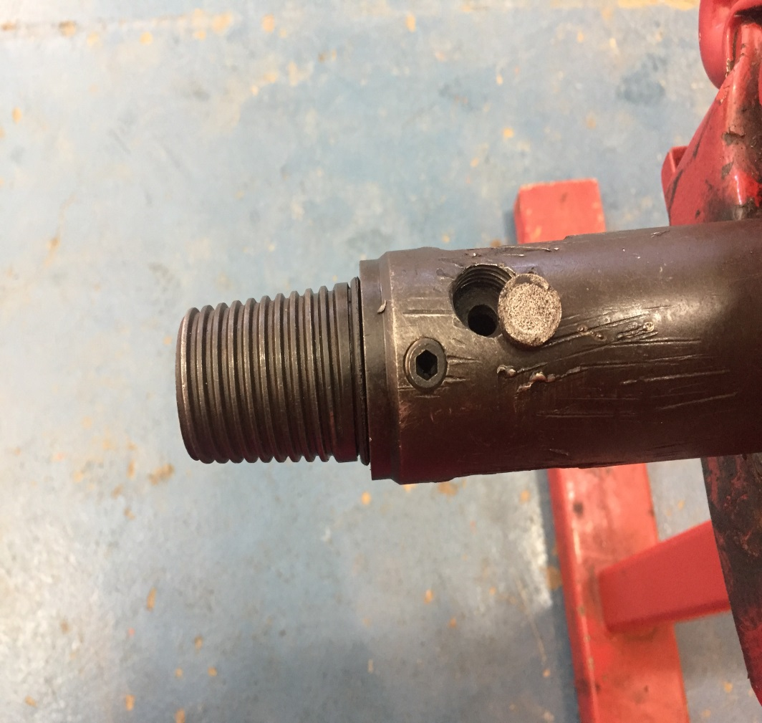
Remove the filter plug (18), washer (19) and snubber filter (20) from the seating dog (17).
E
F

Slide 29
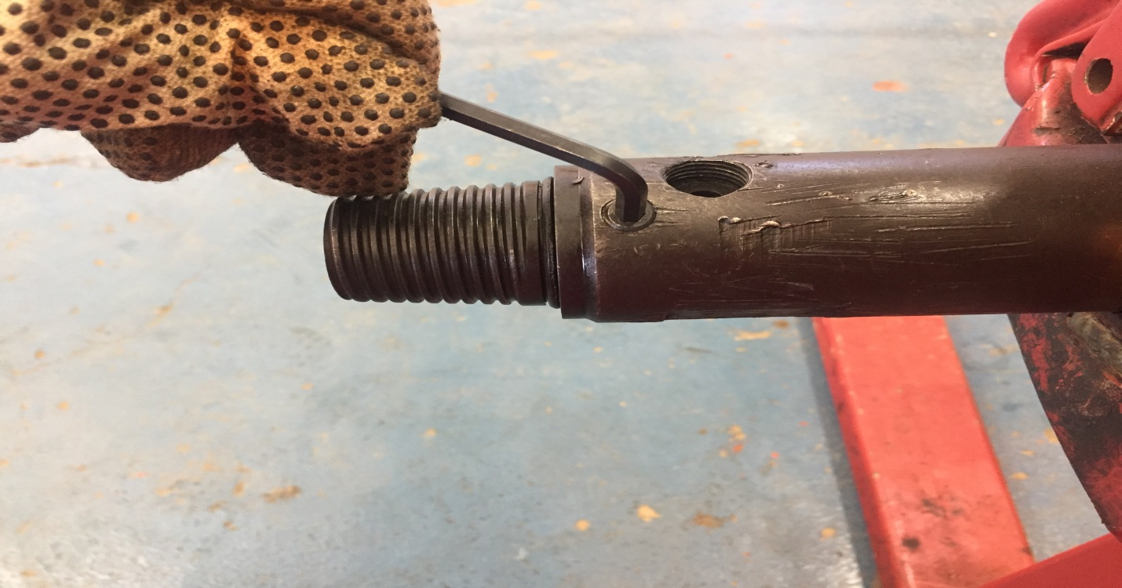
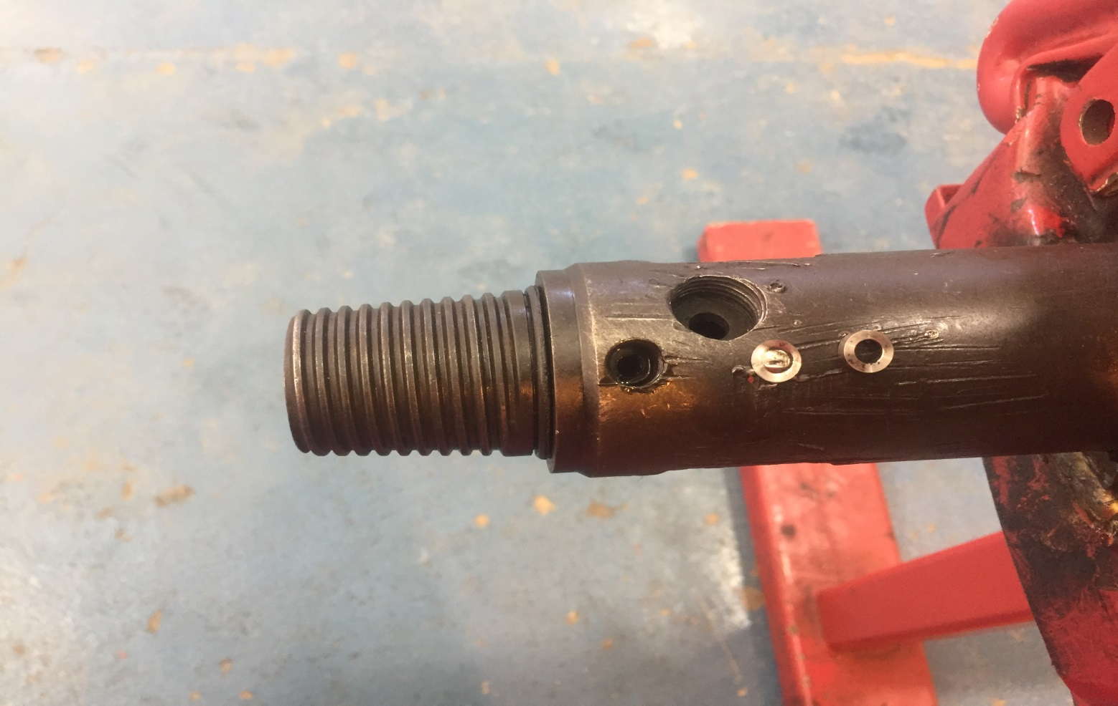
Remove the hold down plug (21), hold down ring (22), rupture disk (23) and O-ring (24) from the seating dog (17).
A
B

Slide 30
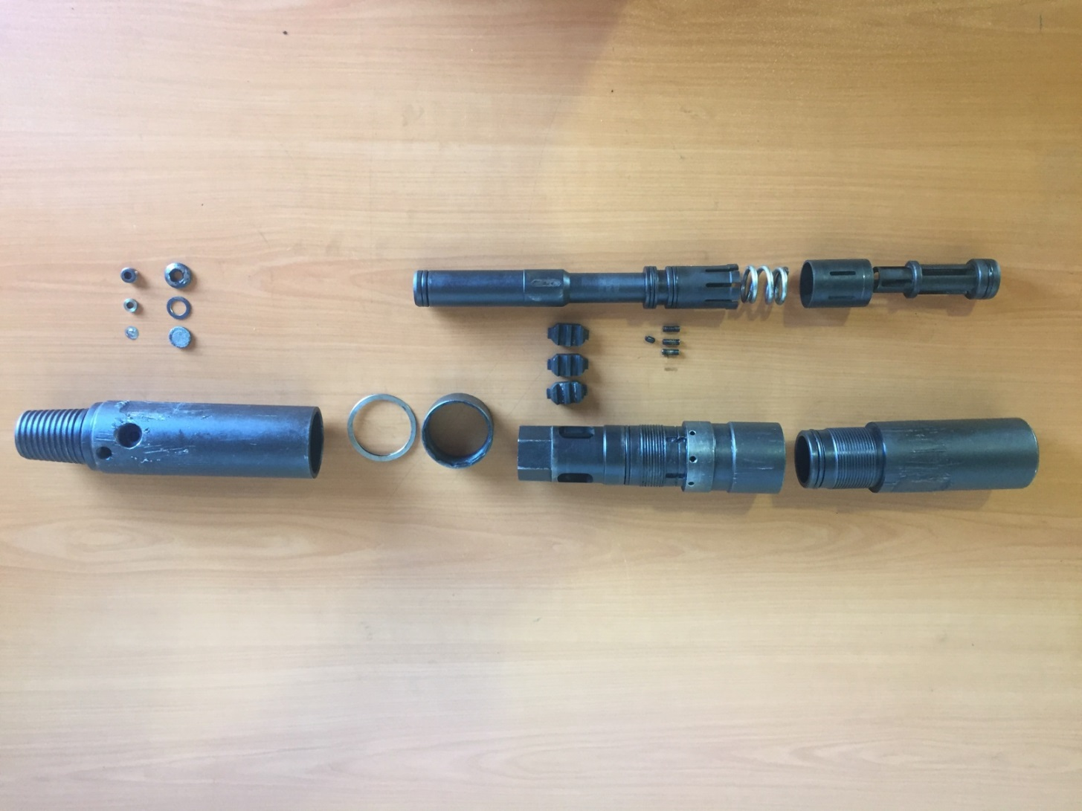
13
20
19
5
18
6
21
4
22
9
23
11
16
15
1
10
12
17

Slide 31
Amount | Description | Item No.
1 | Top Sub | 1
1 | Steel Ball | 2
1 | O-ring | 3
1 | Piston | 4
1 | Compressing Ring | 5
1 | Collet Sleeve | 6
1 | O-ring | 7
2 | O-ring | 8
4 | Shear Screw | 9
1 | Retaining Ring | 10
1 | Locking Pin | 11
1 | Adjusting Ring | 12
1 | Collet | 13
Amount | Description | Item No.
1 | O-ring | 14
1 | Dog Housing | 15
3 | Dog | 16
1 | Seating Dog | 17
1 | Filter Plug | 18
1 | Washer | 19
1 | Snubber Filter | 20
1 | Hold Down Plug | 21
1 | Hold Down Ring | 22
1 | Rupture Dist | 23
1 | O-ring | 24
1 | O-ring | 25
- | - | 26

Slide 32
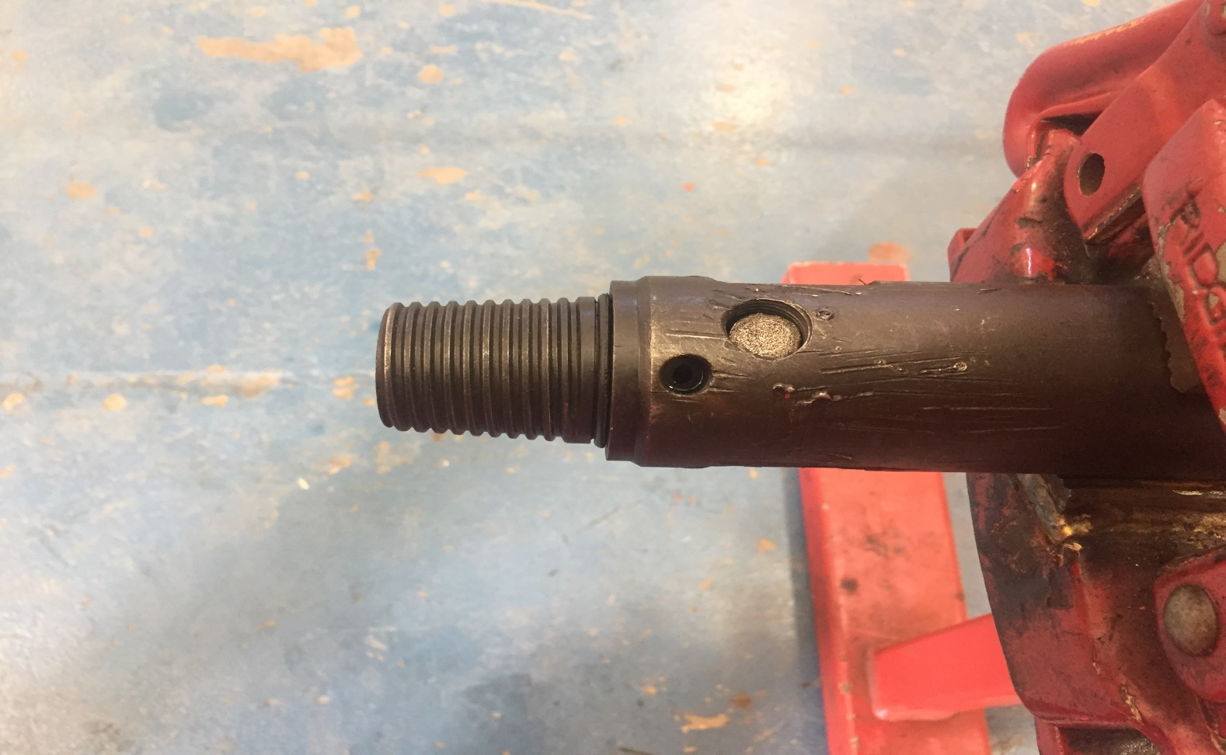
Assembly
Install O-ring (24), snubber filter (20), washer (19) and filter plug (18) onto seating dog (17).
A
B

Slide 33
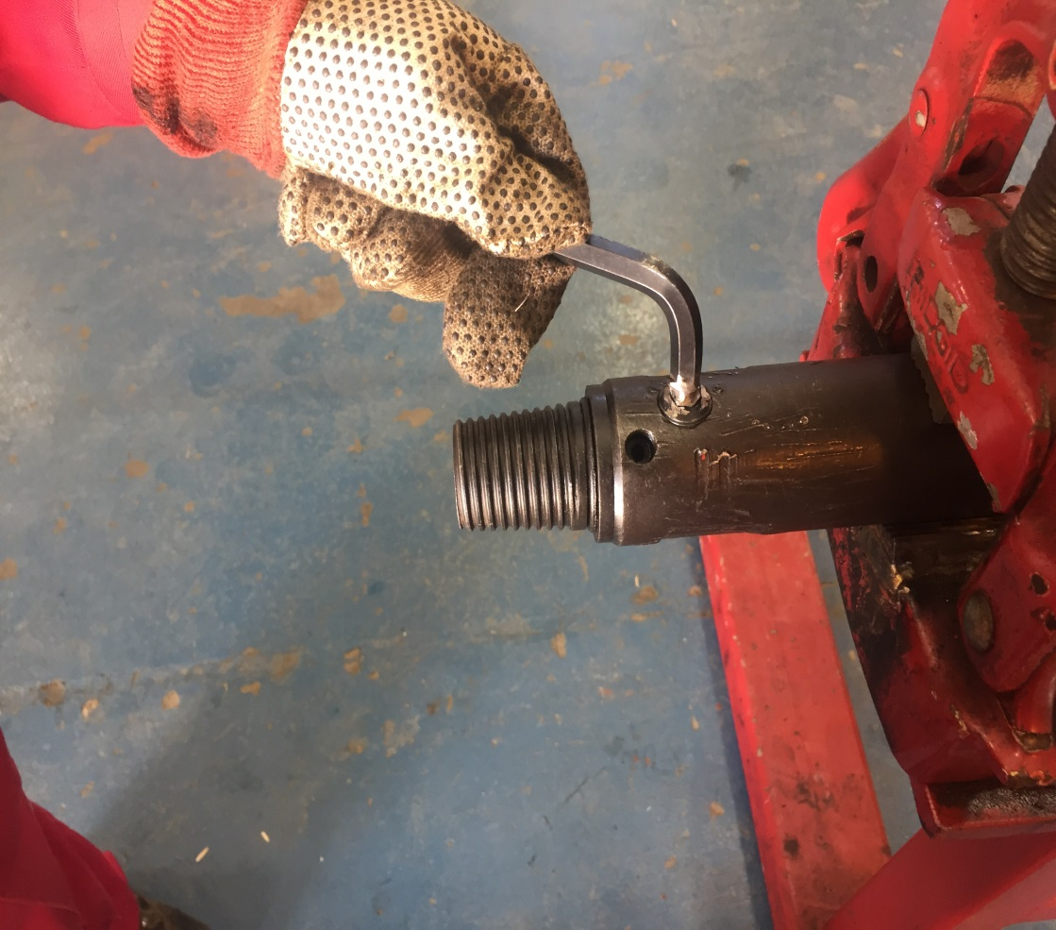
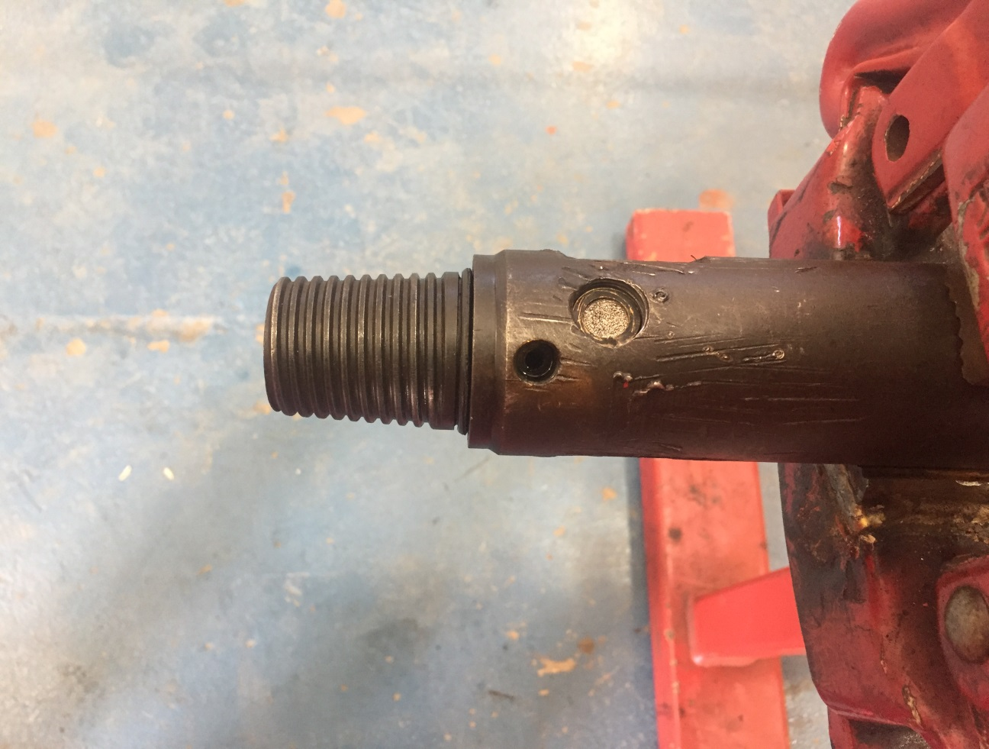
Install O-ring (24), snubber filter (20), washer (19) and filter plug (18) onto seating dog (17).
A
B

Slide 34
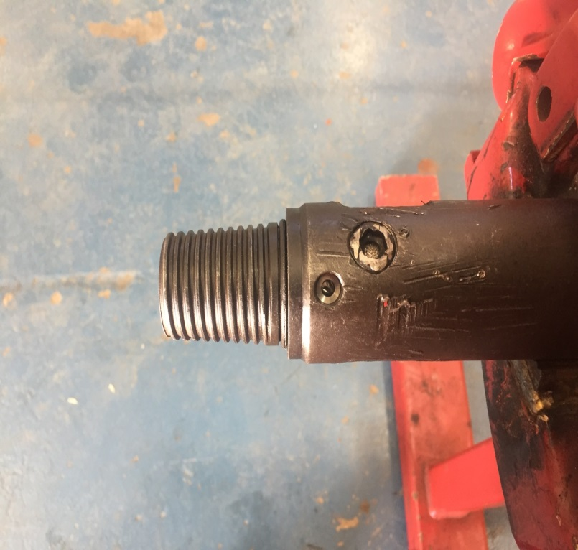
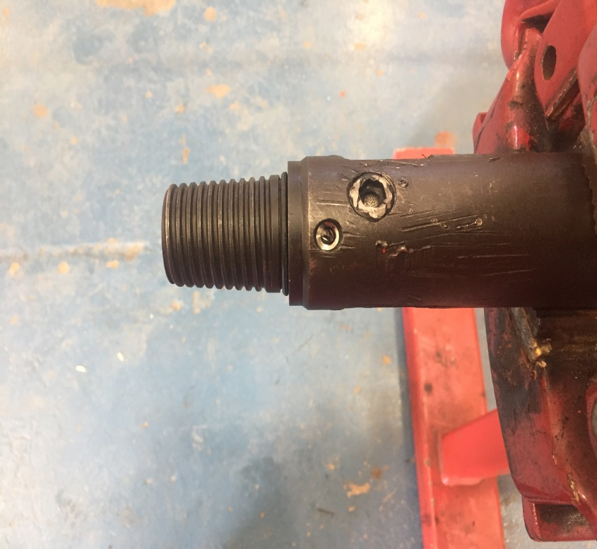
Install O-ring (24), snubber filter (20), washer (19) and filter plug (18) onto seating dog (17).
A
B

Slide 35
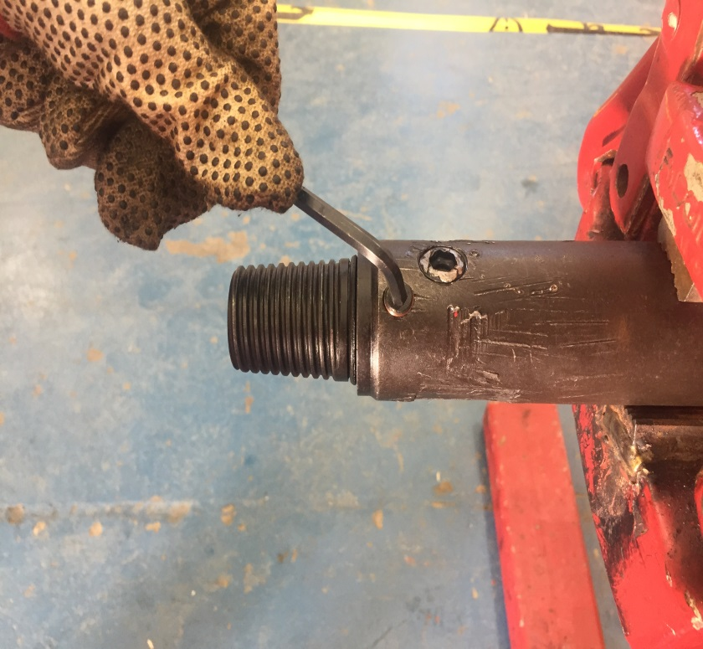
Install rupture disk (23), hold down ring (22) and hold down plug (21) onto seating dog (17).
A
B

Slide 36
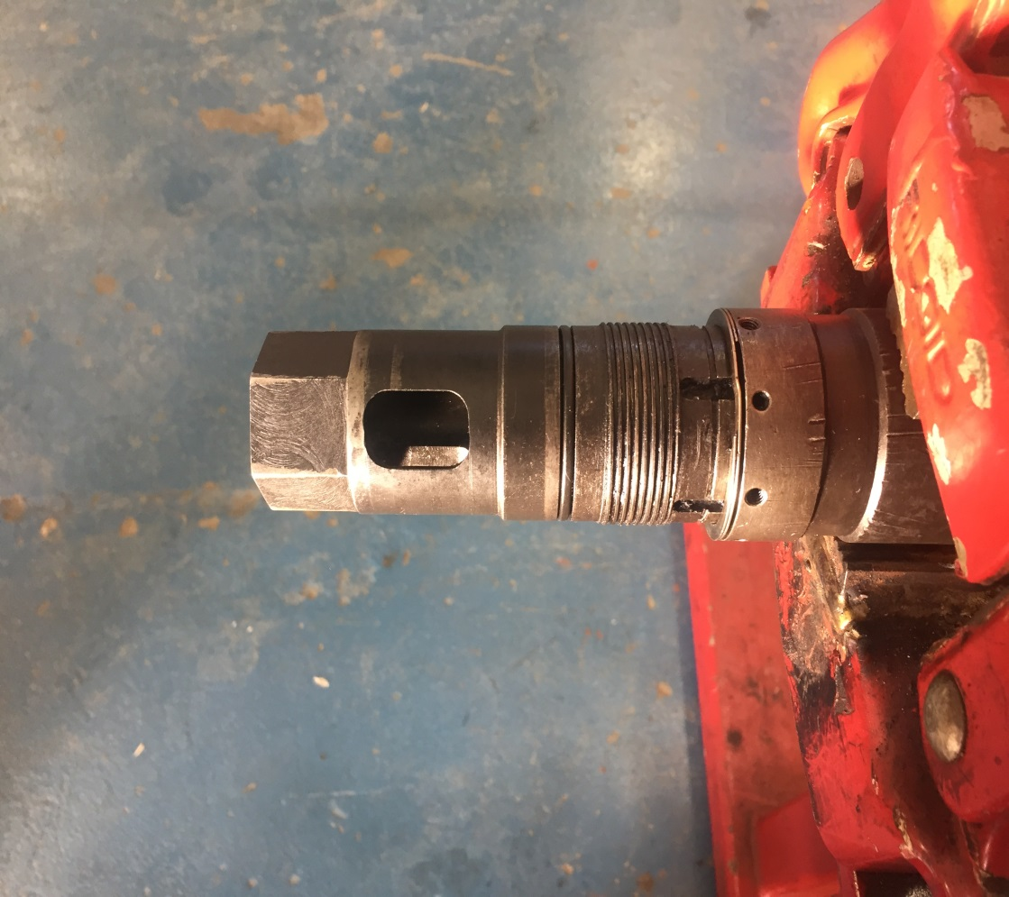
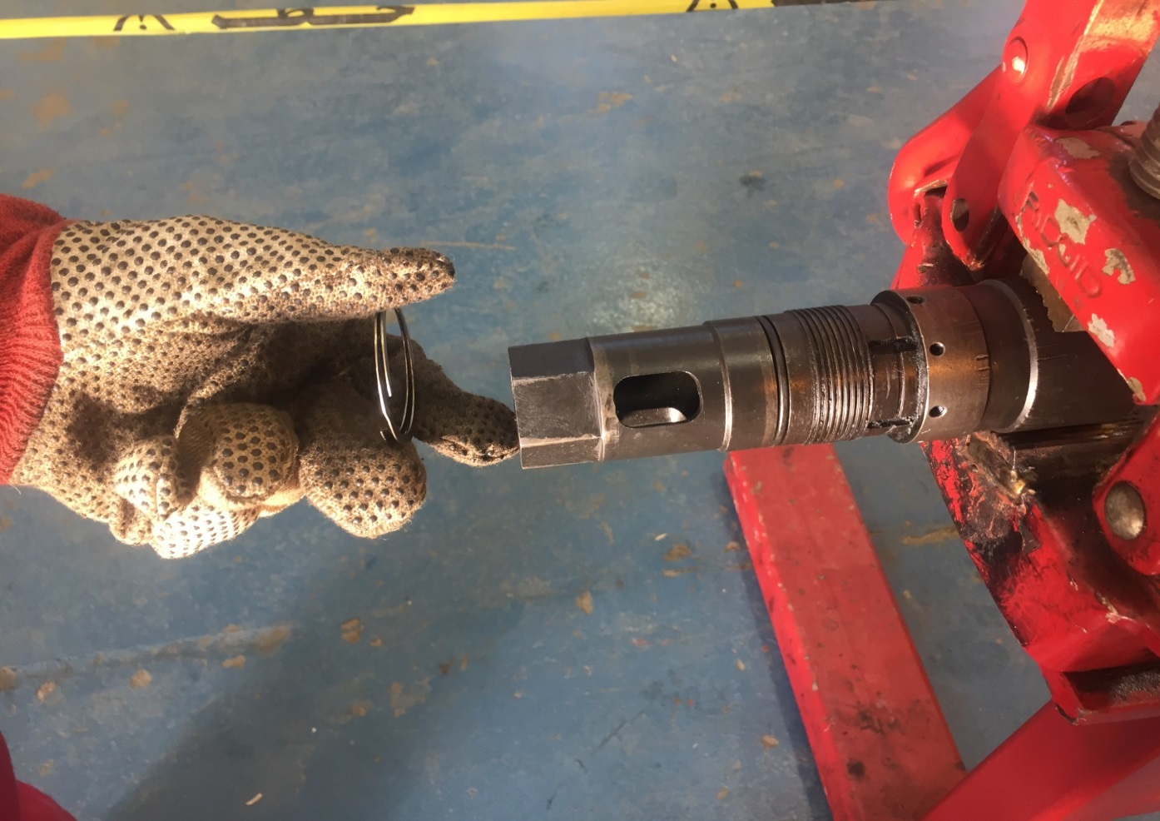
Slide retaining ring (10) over the bottom end of dog housing (15) over thread and against shoulder by the shear screw holes.
A
B

Slide 37
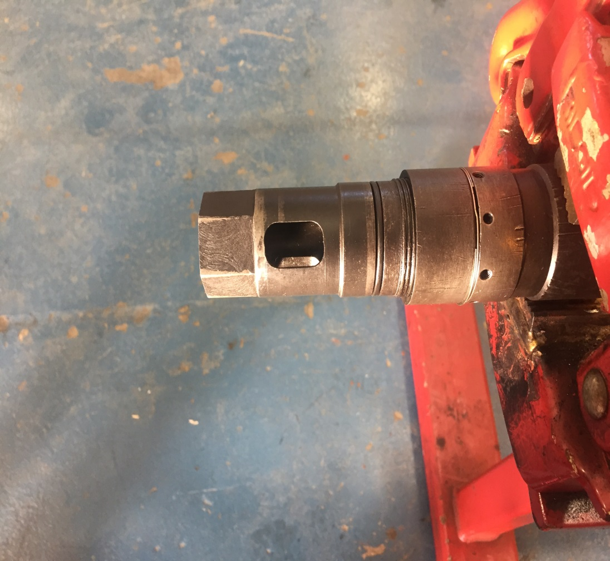
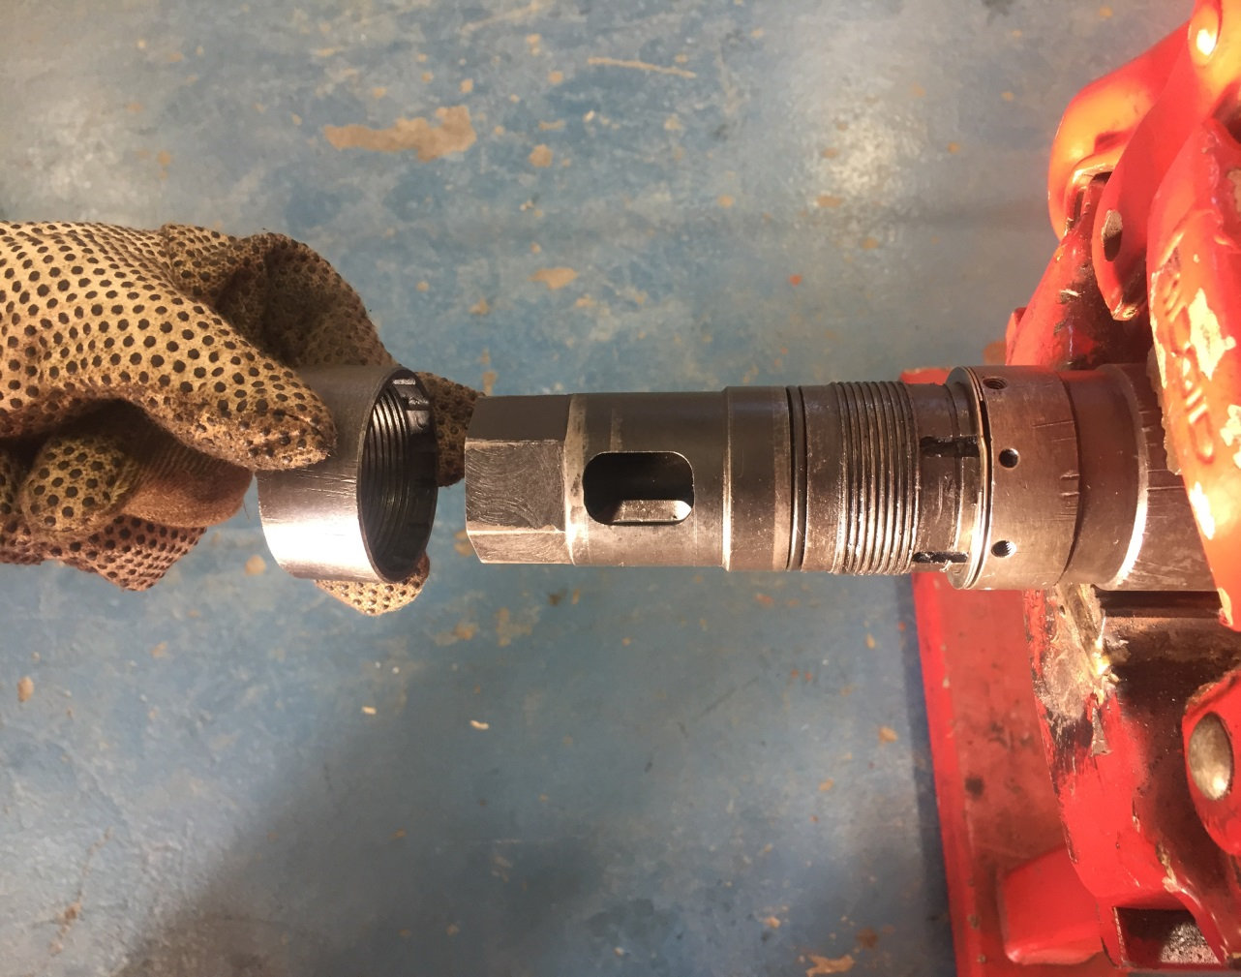
Make up adjusting ring (12) followed by O-ring (14).
A
B

Slide 38
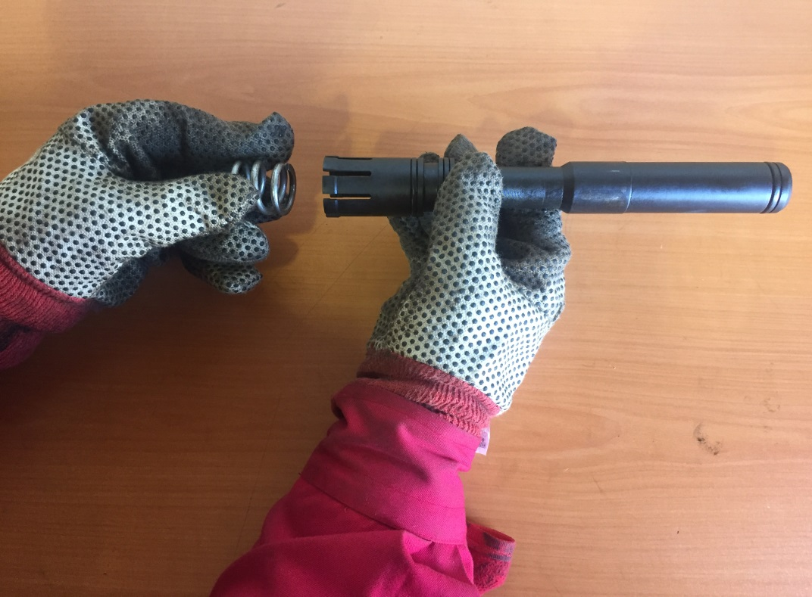
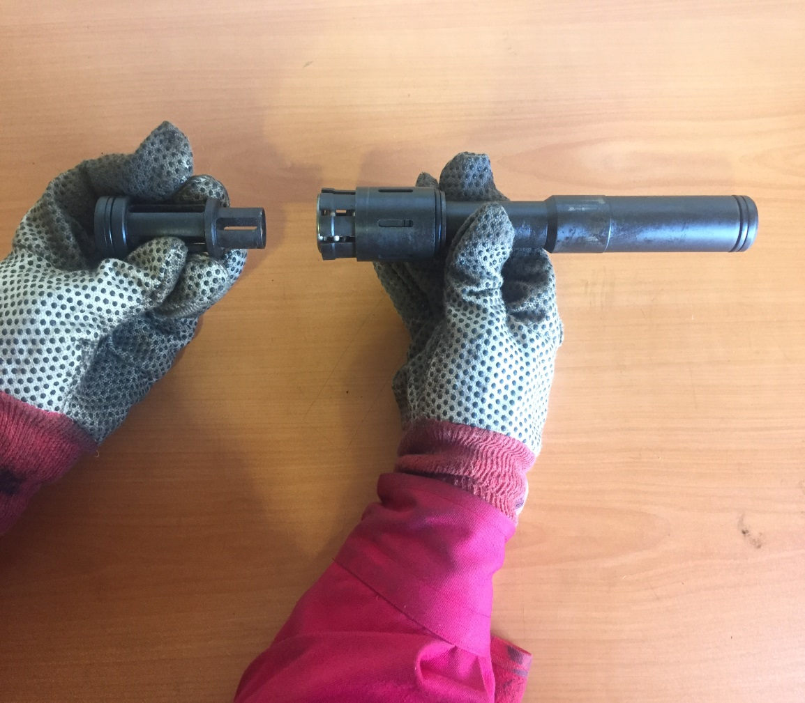
Snap compression spring (5) inside of collet (13) top and slide piston (4) inside of spring (5).
A
B

Slide 39


Slide collet sleeve (6) over the bottom of the collet (13).
A
B

Slide 40


Slide the all-thread assembly tool thru the collet (13) and the piston (4). Tighten up on bottom of tool to compress the spring (5) inside of the collet (13).
A
B

Slide 41
Slide the all-thread assembly tool thru the collet (13) and the piston (4).
A
B
* Note: do not over compress the spring (5) as this will result in damage to the spring. Stop when the collet fingers snap back down allowing the collet sleeve to slide over the top of the collet fingers.

Slide 42


Insert dogs (16) into lower end of dog housing (15) and push out through slots in the housing. Slide the bottom of the dog housing over the top end of the assembly tool until the adjusting ring (12) bumps the seating dog (17).
A
B

Slide 43


A
B

Slide 44


Slide the top sub (1) over the piston (4) and collet (13) until the top shoulders on the collet sleeve (6).
A
B

Slide 45


Slide this assembly into the dog housing (15) and push the assembly tool out of the seating dog (17). Make up the top sub (1) to the dog housing (15). Insert shear screws (9) into the dog housing.
A
B

Slide 46
Well Done!

